Slide 1
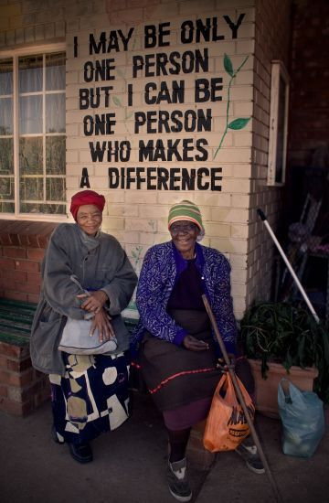
How can we be a person who makes a difference?
God loves us and wants us to care for ourselves to that we can do His work.

Slide 2
Clean your teeth
Do a sport or activity
Get enough sleep
Spend time outdoors
Eat well
Here is the story of how a little yellow packet of good nutrition makes a difference

Slide 3
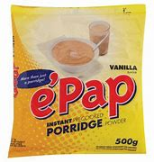
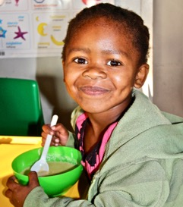
This is a little yellow packet of e’Pap……
….it was developed by a very clever chemist to contain just the right balance of vitamins and minerals for healthy bodies
The powder in this pack makes lots of servings of a nutritious breakfast which looks like this……

Slide 4
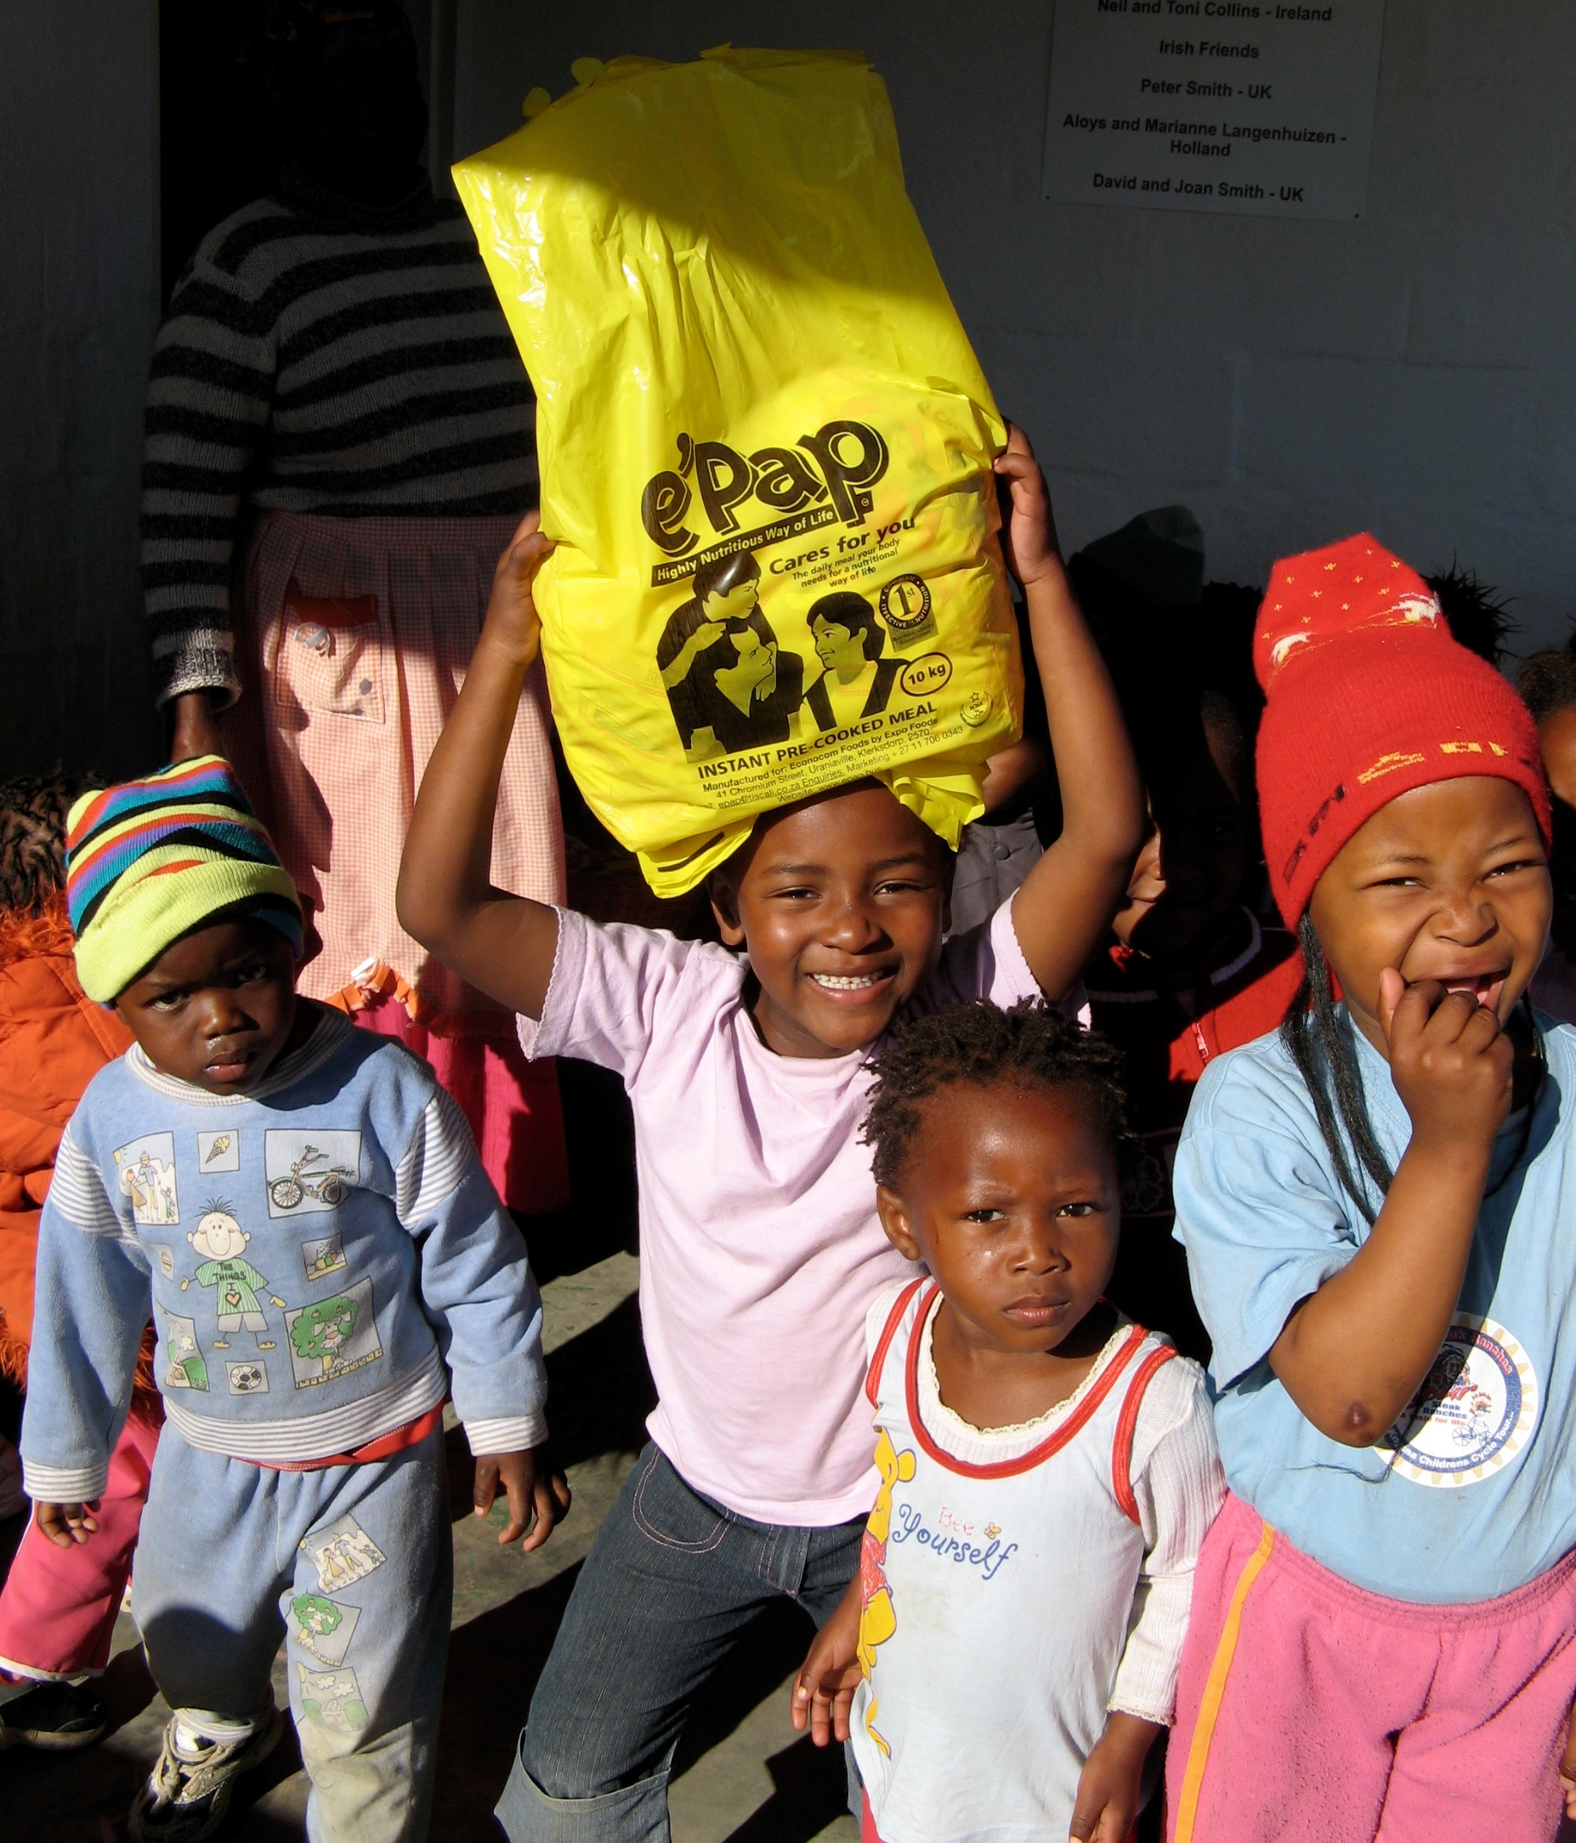


At the GRCT we raise money to fund e’Pap for breakfast for over 8000 children each school morning in South Africa.
Why does a nutritious breakfast make such a difference that we raise funds to make it happen?

Slide 5
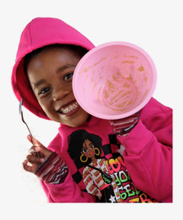
A bowl of e’Pap for breakfast…..
…is a reason to come to school
….is more nutritious that rice or maize porridge which might be all there is at home. There are no school lunches
….helps energy & concentration for morning lessons
….like a balanced diet helps us all not catch colds and viruses

Slide 6
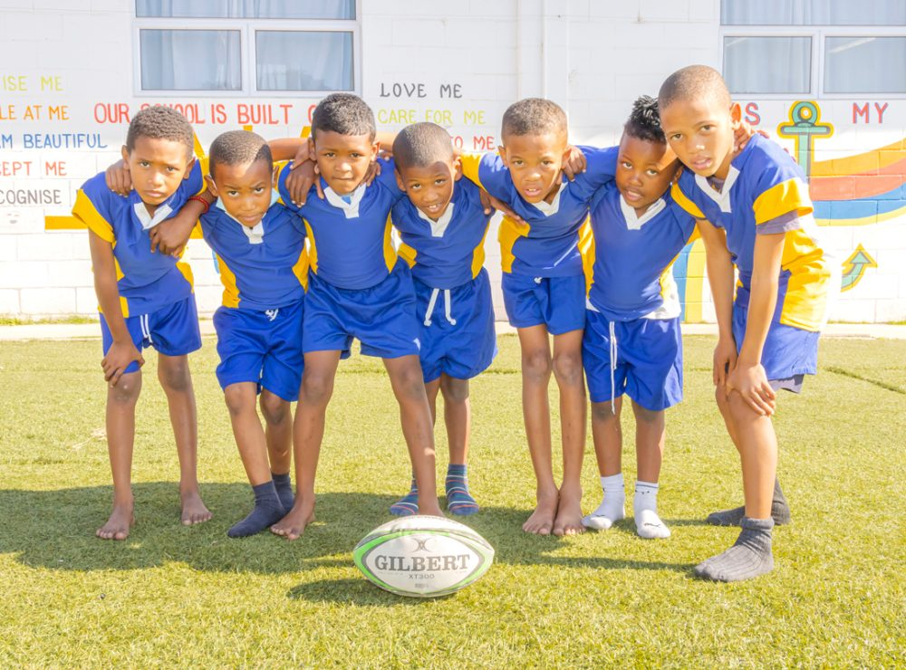
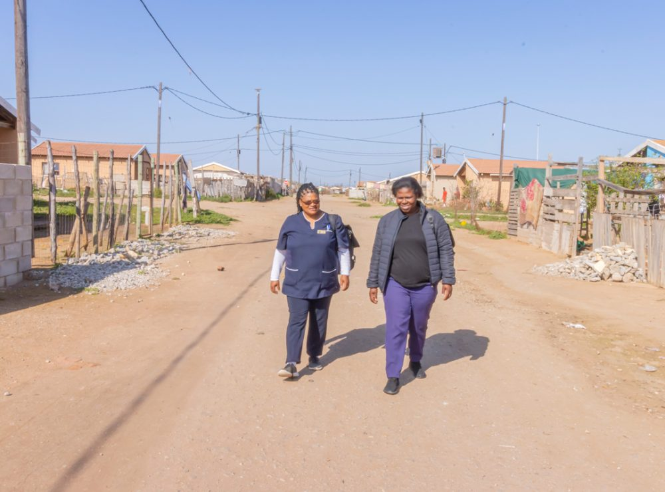
These boys go to school in a tough place called Missionvale. Since the school started serving e’Pap for breakfast they have had the energy to learn to play rugby.
Two boys like these eventually got rugby scholarships to secondary school. The first ever from Missionvale School.

Slide 7
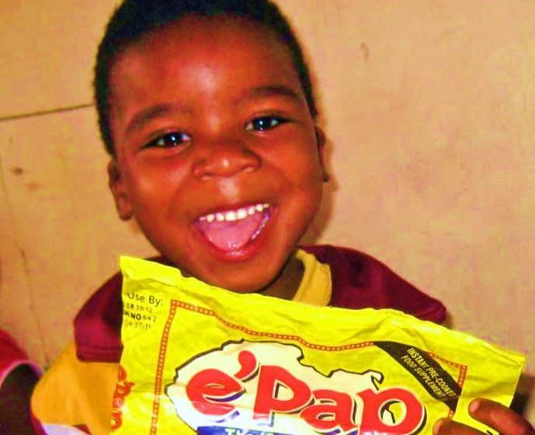
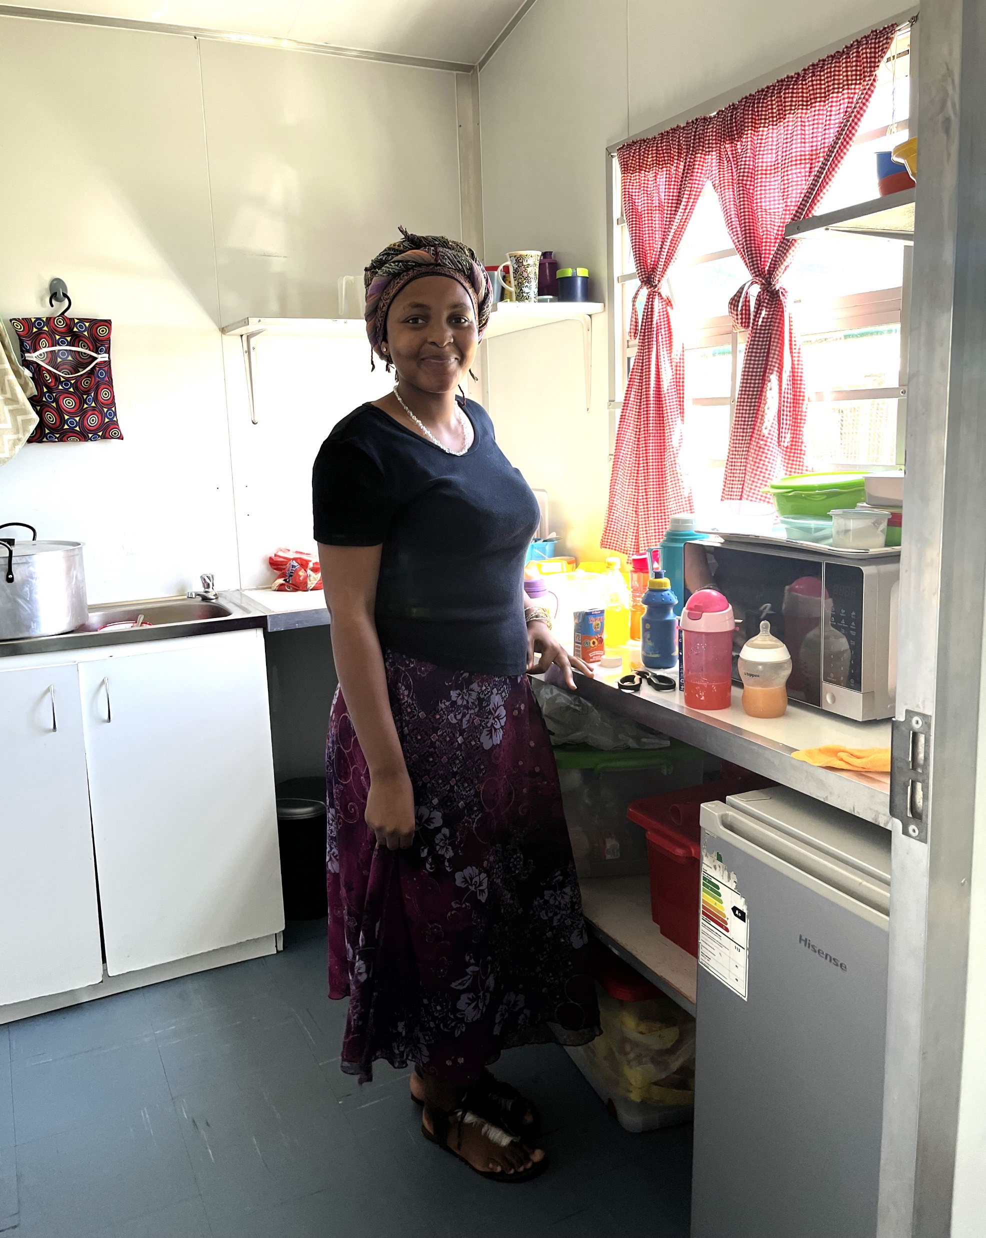

It doesn’t take much to help us provide e’Pap for breakfast
This is Nora. She works in a creche in Addo in South Africa.
If you look closely you can see the box of packets of e’Pap at her feet.
Each packet costs about £1.50 and has about 20 Servings depending on the age of the child.
Even if you can only give us 10p you can help us buy a child a nutritious breakfast which will help them concentrate.

Slide 8

One idea which is fun fundraising is
And we’d be happy to help.
If you would like more information go to
www.grct.org.uk

Slide 9
With these ideas you can be a person who makes a difference.

