Slide 1
Leader: We are here together
Children: With ears ready to hear and hands ready to serve.
ALL: May we be wise in all our actions today.
Notes:
Slide 1: Use our new gathering words. Why not invent your own actions to accompany them?
Leader: We are here together
Children: With ears ready to hear and hands ready to serve.
All: May we be wise in all our actions today.

Slide 2
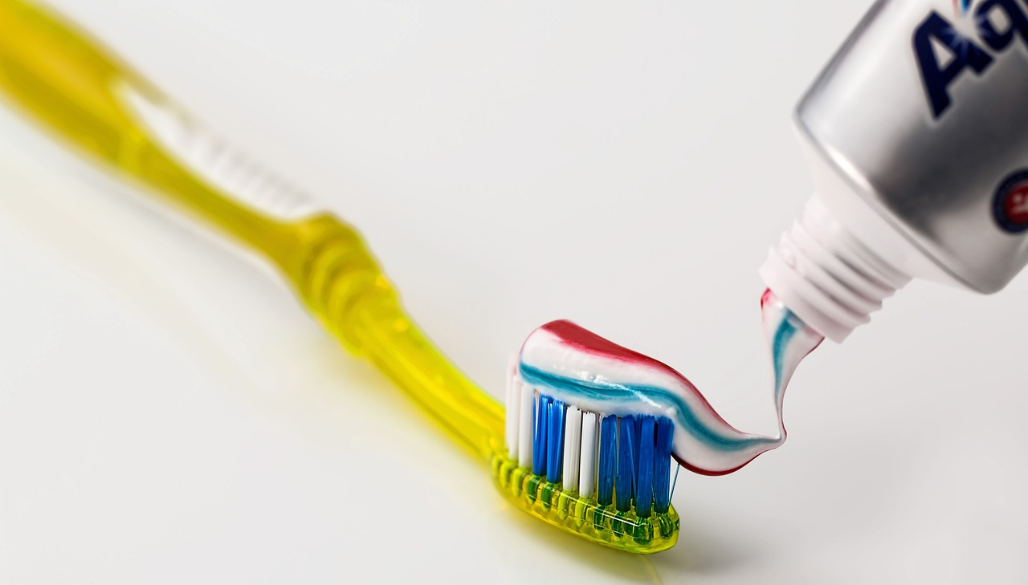
The Toothpaste Challenge!
Notes:
Slide 2: We are starting today with a challenge – with a tube of toothpaste! (and a toothbrush!)
Choose a child (carefully! – see instructions in Resources section, above) to squeeze some toothpaste onto the brush.
The real challenge is to try to put it back into the tube again, which of course, is impossible! Make sure that your volunteer feels that they haven’t failed!

Slide 3
Notes:
Slide 3: We introduced our theme last week of Wise Words, which you might remember come from wise King Solomon. Let’s hear some words from him, not about toothpaste (which we will come back to in a moment!), but about some other familiar objects….
Let’s read them together…..

Slide 4
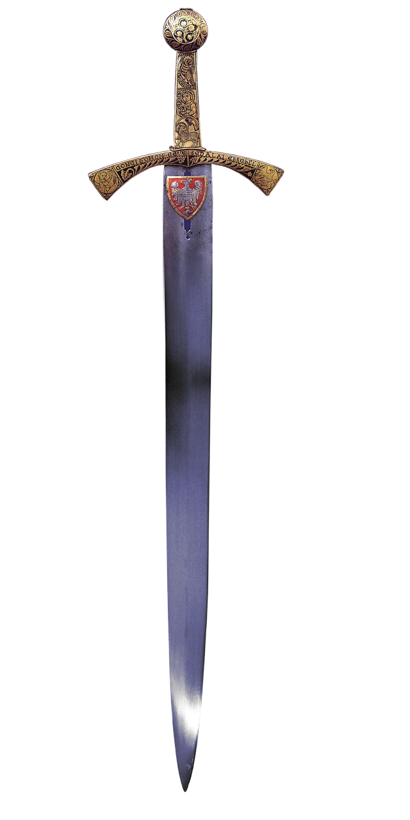
‘Careless words stab like a sword. But wise words bring healing.’ (Proverbs 12:18)
Notes:
Slide 4: ‘Careless words stab like a sword*.
But wise words bring healing.’
These are an example of Solomon’s pairs – where one part of the phrase is negative, and the other positive.
I wonder if we can think of some words that are like ‘swords’ and some words that are ‘healing’.
[You may need to think of some examples – perhaps your class could help you with that? Spend some time working with assembled pupils’ suggestions, teasing out what makes them ‘sharp’ or ‘healing’. You could even gather some examples to keep in your reflective areas to help provoke thinking during the rest of the week.]

Slide 5
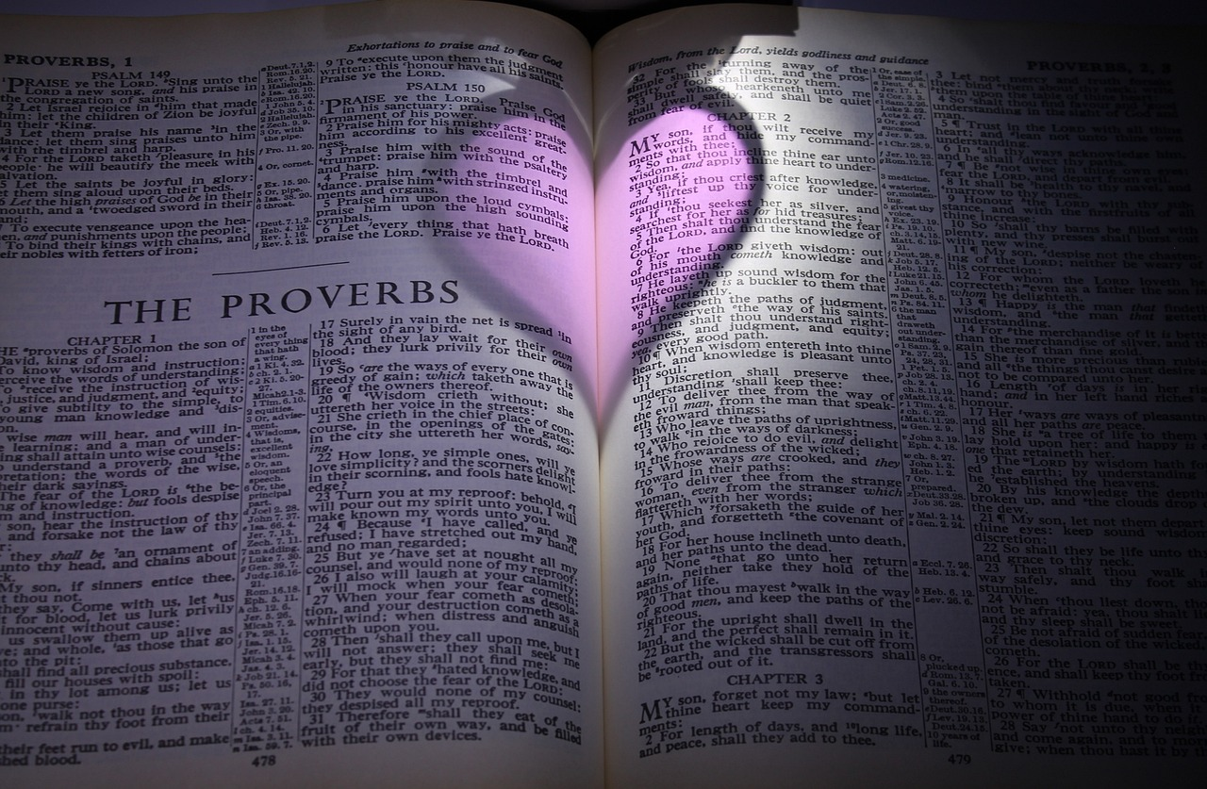
Notes:
Slide 5: As we know from last week, Solomon’s wise words are all found in the book of Proverbs, in the Bible. His words today have helped us to think about the power that our words have to hurt people, or to heal them.
But we also have many books of our own that can help us to continue to think about the power of words. One of my favourites is…. [use the picture book that you have chosen in the way that you want to use it] You might want to use some of your own class favourites during story times this week.

Slide 6
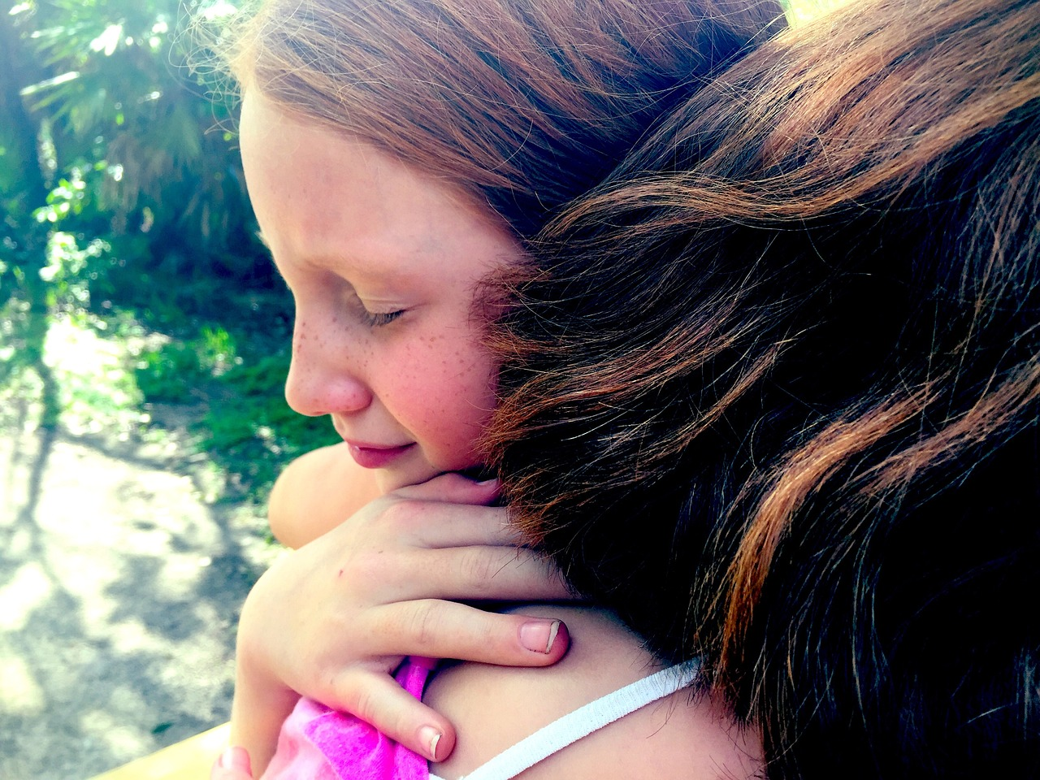
Reflection Time
Notes:
Slide 6: As we are still and quiet together now, you might be thinking about words that we could speak this week that will heal, not hurt. Close your eyes for a few moments now and think about the power of words…… [leave a good space here]

Slide 7
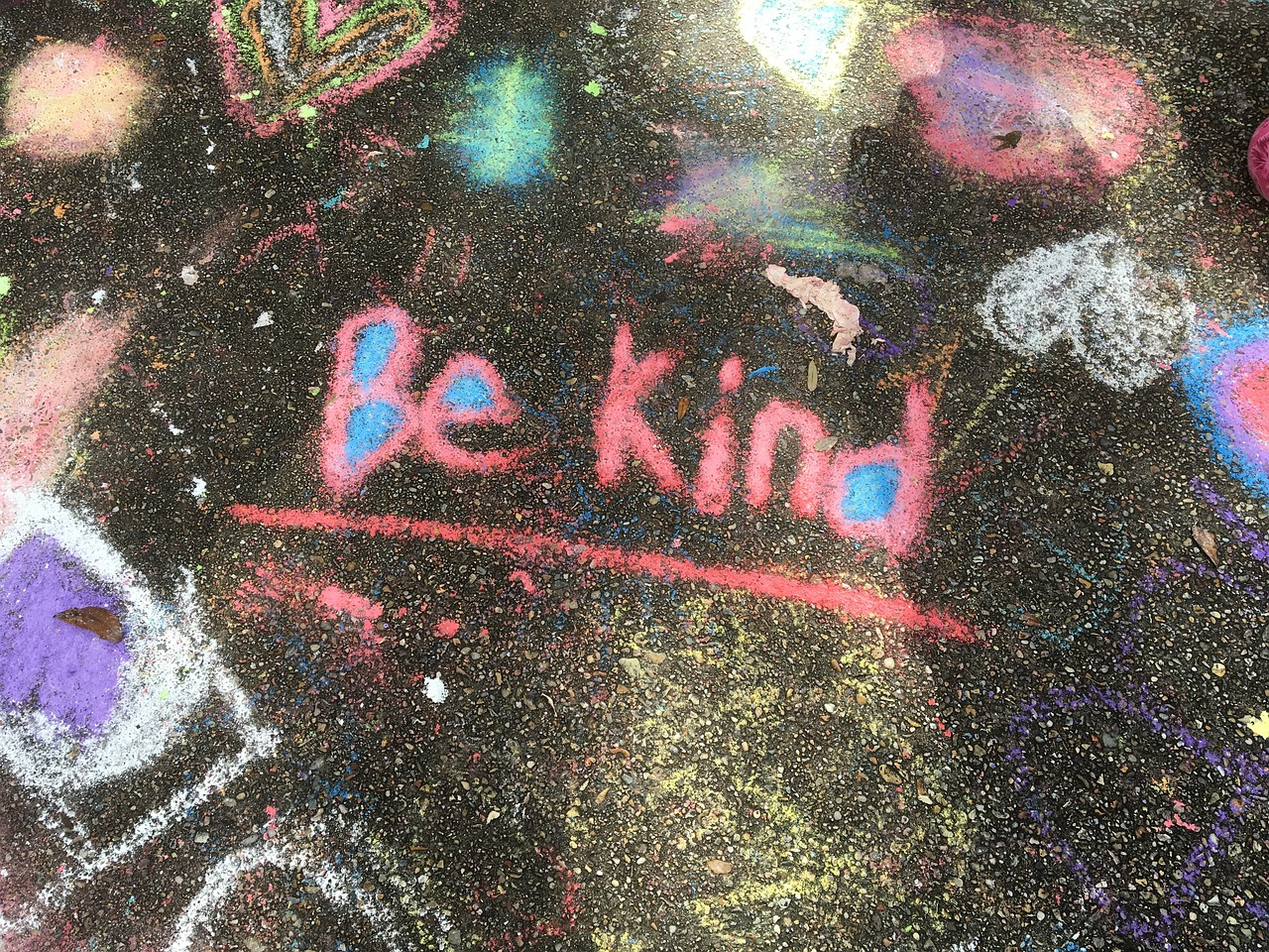
…..I wonder what we might learn from Solomon’s wise words this week?....
…..I wonder if there are words we’ve said that we have later regretted?.....or words that we need to say to someone else to make them feel better?....
….I wonder what might help us to follow Solomon’s advice in our school this week?....
Notes:
Slide 7: Words for worship
We’ve been thinking today about the power of words – to hurt, and to heal.
…..I wonder what we might learn from Solomon’s wise words this week?....
…..I wonder if there are words we’ve said that we have later regretted?.....
…..or words that we need to say to someone else to make them feel better?....
….I wonder what might help us to follow Solomon’s advice in our school this week?....
You might be thinking especially about words that have been hurtful – maybe words that have been said to you, or words that you might have said to others. In our school community, we sometimes need to say sorry if we have hurt others – and it’s true of our words as well. Saying sorry and being forgiving is an important part of us being able to live well together. If there is something that you need to put right, then today is the day to do it. We can help you to do this if you need us to.

Slide 8
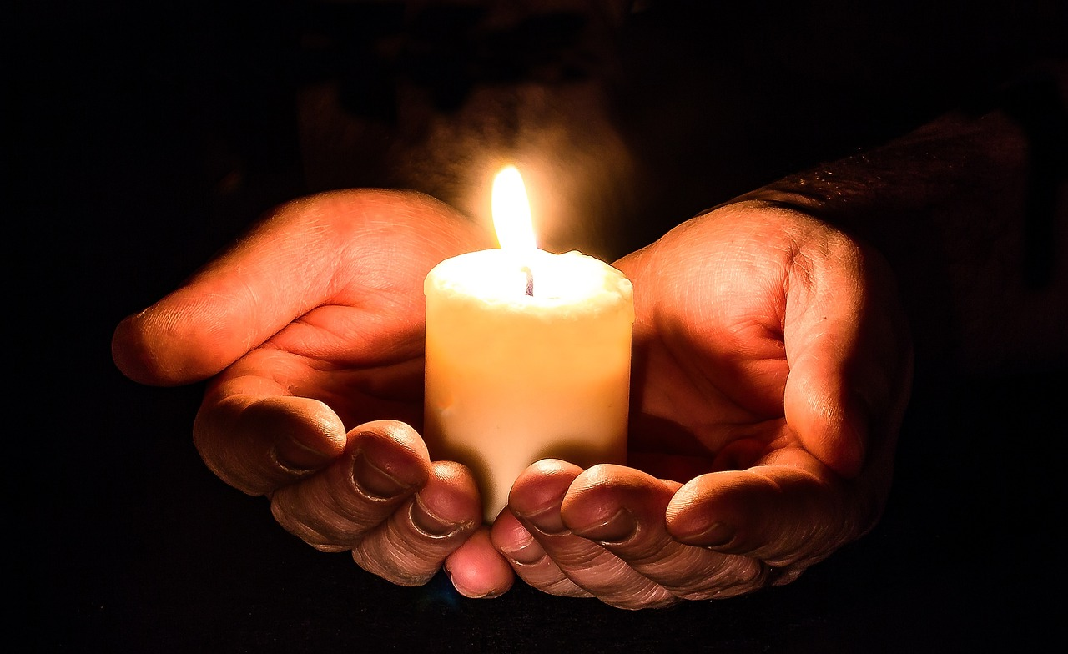
‘May the words of my mouth and the thoughts in my heart please you, O God.’
Notes:
Slide 8:
For our prayer today, I am going to use some words written by wise King Solomon’s son, David – yes that David, the Shepherd-King!
Let me read them to you before I pray them and invite you to join me if you wish to.

Slide 9
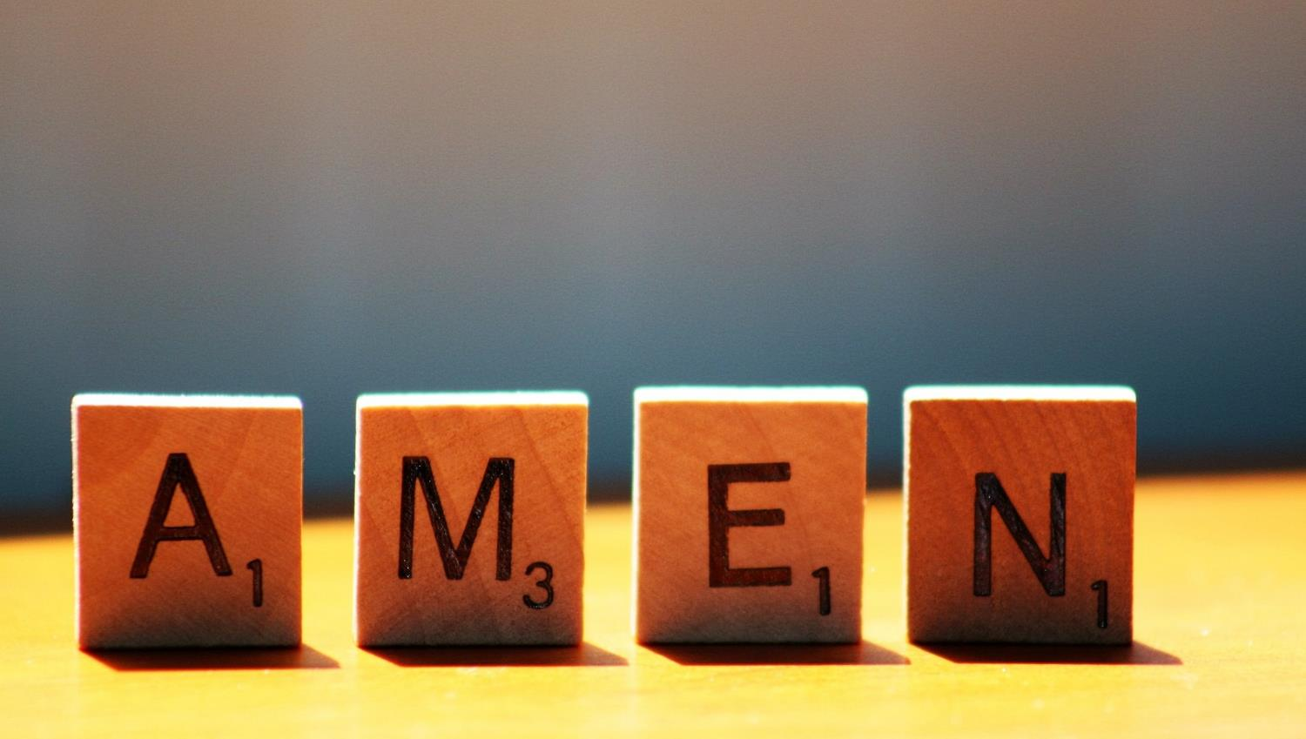

Slide 10
Leader: As we leave this place & time and go into the day ahead…
All: May today’s words help us to make wise choices.

Slide 11
Notes:
Slide 11: Reflective areas
Make sticking plaster shapes & write healing words on them

