Slide 1
Online Faculty System

Slide 2
Prelims
Fire Alarms and Exits
Questions
Notes
Breaks
Notes:
No anticipated fire alarms, so if there is file outside and assemble outside
Please ask questions as we go along. Depending on time we will look to take questions at the end.
Feel free to take notes as you go along but the presentation will be made available electronically afterwards.
We will try to have short break half way for comfort break and leg stretch

Slide 3
Range
Duration – 1hour - 1:15hour
Objectives:
Understand what the Online Faculty System is.
Understand the functions of the Online Faculty System.
Understand how to navigate the Online Faculty System.
Start and edit List A, List B and Faculty applications

Slide 4
Scope
Interest
Who are the Church Buildings Team and what do we do?
What is the Online Faculty System?
Getting Started and navigating the Online Faculty System
Logging List A items
Applying for List B works and developing a proposal
Applying for a faculty and developing a proposal
Notes:
Who here has already engaged with the online faculty system?

Slide 5
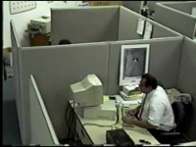

Slide 6

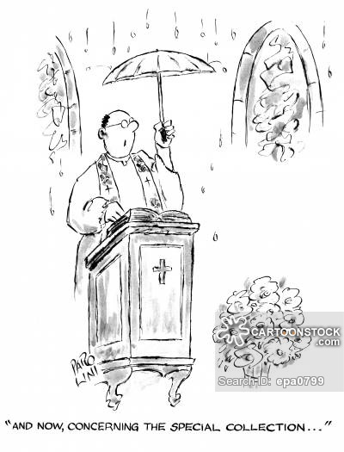

Interest
Why?
Notes:
Why do we have the Online Faculty System? What was wrong with paper?
The online faculty system allows us (The church buildings team) and yourselves to more effectively manage the applications required to keep the church and churchyard maintained.
So far this year the DAC at their meetings have discussed 122 applications. That is not including List A or B applications. There are approximately 28 members on the committee so can you imagine before every meeting photocopying all those applications and sending them via post to the members?
How many people have had things lost in the post or delayed? The amount of amendments to applications that are needed and new documents needed. It is easy to understand why a computer based management system is needed.
This presentation is focused primarily on understanding and using the online faculty system so that you don’t end up like the chap in the video.

Slide 7
Who are the Church Buildings Team and What do we do?
The Church Buildings Team:
Dan Crooke – Church Buildings Officer and DAC Secretary. Dan works Monday – Friday 9-5
Alex Weedon – Assistant Church Buildings Officer. Alex works Monday – Thursday 9-2.30
Email: dac@salisbury.anglican.org
What we do and who we support:
PCC’s & individuals applying for work under the Faculty Jurisdiction Rules (FJR).
The Diocesan Advisory Committee, a voluntary committee comprising: Chairman, the Archdeacons, 4 Architects, and 14 specialists.
Notes:
Currently there are two of us in the CBT although we will be hoping to recruit another member shortly.
The Church Buildings Team (CBT) supports the work of the Diocesan Advisory Committee (DAC) and can advise parishes on a wide range of matters relating to the care and use of church buildings, and the nature of permission required for works to be carried out. We also liaise with a number of amenity societies and architects and the Chancellor in order to get the right advice as quickly as possible.
The team administers applications made on the Online Faculty System (OFS), which includes parish applications for either Faculty Applications or the Archdeacon’s Written Approval under List B provisions, and also the operation of the quinquennial inspection (QI) scheme, on behalf of the Archdeacons. The team can guide applicants in using the OFS, arrange site visits with the DAC/statutory bodies if needed and liaise with statutory bodies when required. The CBT can consult with the Registry Team when needed.
Anyone can administer an application on the online faculty system as long as they have the permission from the PCC to do so. It does not automatically make them the applicant but often it is.
The CBT presents appropriate Faculty applications to the DAC on a monthly basis to ascertain their advice and reports the outcome of the meeting to the applicant.

Slide 8
What is the Online Faculty System?
The OFS is an online portal enabling PCC’s/applicants to process their applications in an accessible online format.
The OFS is only accessible to registered users, Church Building Team members, DAC advisers and statutory bodies.
Registered users and CBT members can create, view, access and amend applications. DAC Advisers and statutory bodies can only view applications.
There can be more than one user registered to a church and users can have multiple churches to their account.
You will receive automated emails from the OFS with status updates relating to your application; some spam/junk filters will ‘trap’ these emails. Please consider adding the OFS email address noreply_onlinefaculty@churchofengland.org to your safe senders list, or address book to ensure you receive their emails.
Notes:
You must register before you can gain access and we will show you how to do that later on.
As administrators the CBT has a lot of editing ability within the OFS so if you get stuck we can help.
Anyone that has their account linked to a particular church can view and edit an application. This is helpful as the workload can be shared amongst PCC members or architects can upload drawings directly.

Slide 9
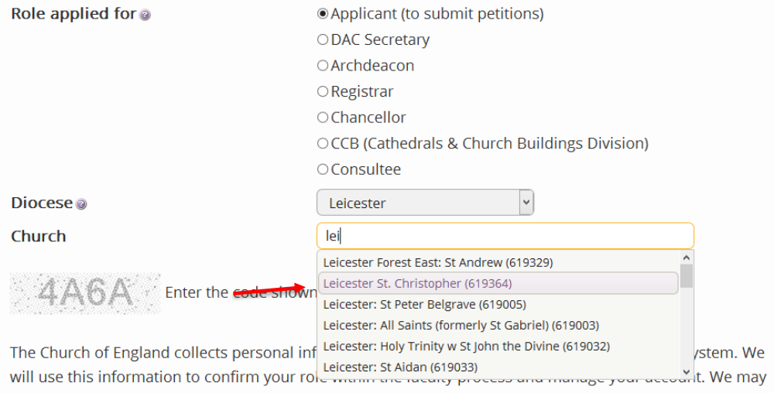
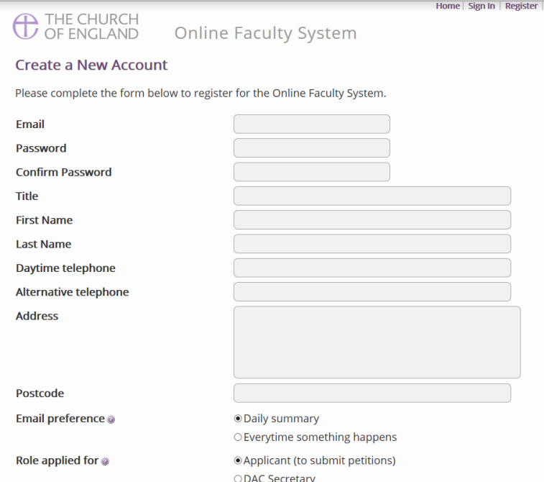
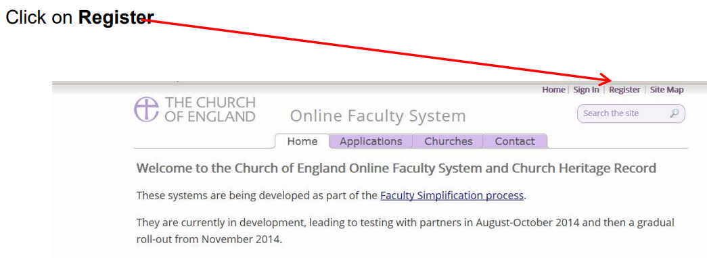
Registering (https://facultyonline.churchofengland.org/home)
Notes:
First step is to go onto the online faculty system and click register.
Next is to fill in the relevant details. Be sure to click applicant or the OFS administrators get funny.
Lastly REMEMBER to link a church to your profile. If you do not do this you will not be able to access the system.
You will receive a confirmation email to confirm the email account. Again if you don’t do this your account wont work.

Slide 10


Navigating the Online Faculty System
Common Symbols
Magnifying Glass
Notebook
Hourglass
Tick
Notes:
This first symbol will allow you to view whatever document or application it is next to
This symbol will allow you to edit whatever form it is next to. This will be visible at certain times and not at others as the application progresses
This symbol means the relevant document requires completing. Often if the application has this symbol it will not allow you to submit it forward
Lastly this symbol means all is done and not further action required.

Slide 11
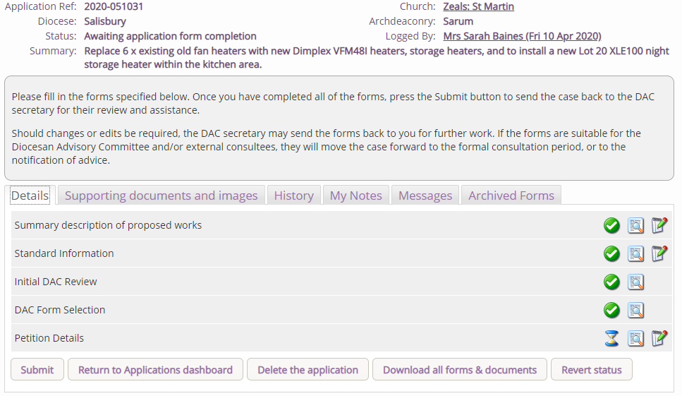
Navigating the Online Faculty System
General orientation
Notes:
This is what the application dashboard will look like.
1. This area of the Dashboard displays the relevant details of the application and its status
This area will give you any relevant instructions required and will change depending on the status of the application.
These tabs will navigate to other areas of the application. The most important to the applicant is the details and supporting documents tab.
This area is where you will find the standard online documents to fill in. This will expand as the application progresses
Finally these are the ‘action’ buttons. These will make the application do something, either submit to the CBT and DAC or delete etc.

Slide 12
List A and B
List A and List B set out matters which may generally be undertaken without a Faculty, subject to specified conditions. The list forms Schedule 2 of the Faculty Jurisdiction Rules. This list can be found on our website.
List A matters can be undertaken without a Faculty and without the need for consultation, however they should be logged on the OFS to ensure a record of works undertaken is kept.
List B matters can be undertaken without a Faculty but only following proper consultation and at the determination of the Archdeacon. List B matters are not limited by cost or scale but by the Faculty Jurisdiction Rules.
IF IN DOUBT ASK!!
Notes:
List A and B is not always black and white. For obvious reasons they couldn’t list everything. Ultimately it is the Chancellors decision whether something can be done under List A, B or Faculty.
We are here to answer those questions. If you undertake work on a List A when it was a List B or Faculty the PCC will have to make a retrospective faculty and pay the legal costs for that as well which is in the region of £300

Slide 13
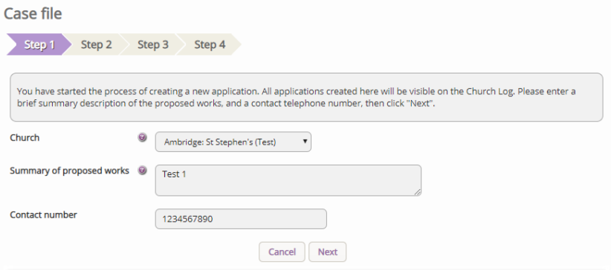
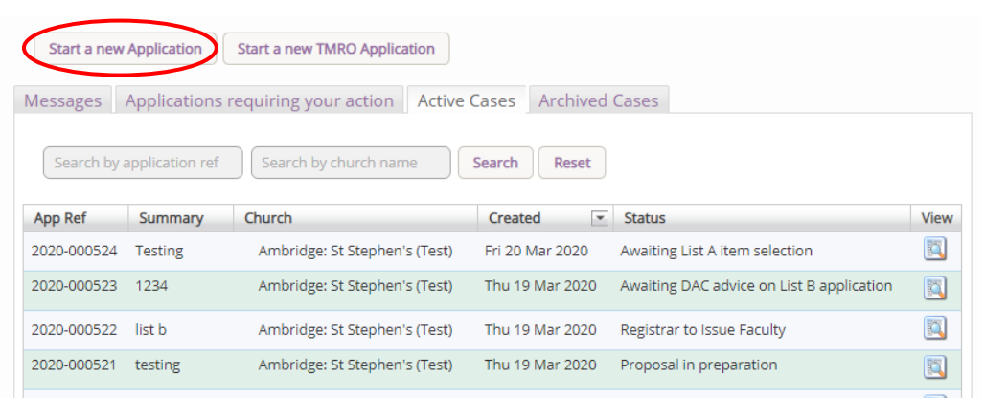
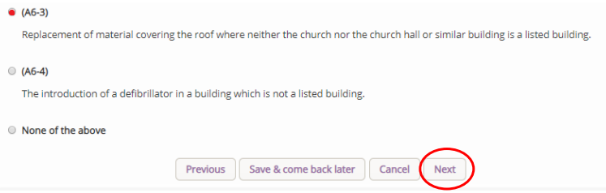
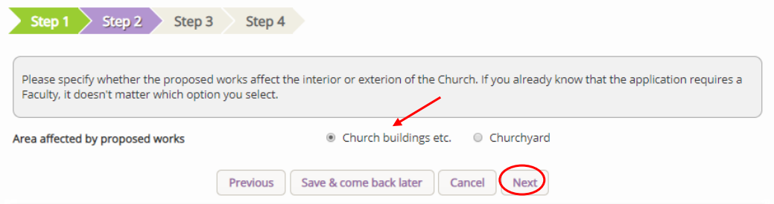
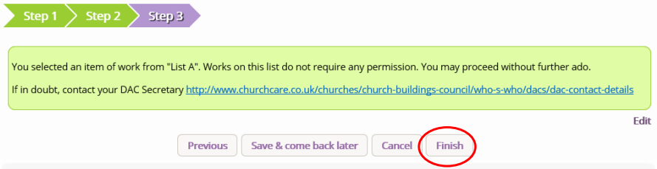
Logging List A matters
Notes:
1. Start from the dashboard and select ‘start a new application.
2. There will be a couple of boxes to fill in.
3. Select whether it is the church building or churchyard
4. List A works appear first when you start an application on the OFS, and will not require supporting documentation. Select the relevant List A.
5. Click finish and its all done.
It is important to complete a List A application on the OFS to keep a proper record of works undertaken in your church. If you have multiple works complete a List A for each one.
If you are unsure whether your works fall under List A please contact the CBT for advice.

Slide 14
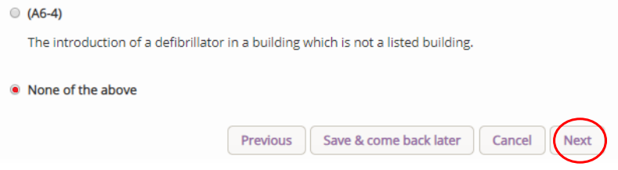
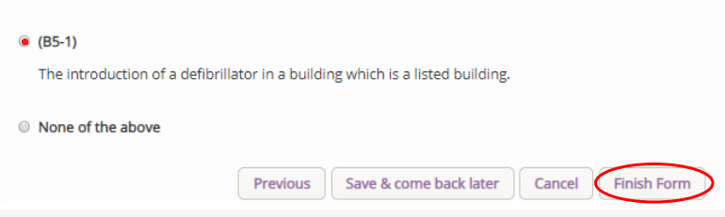
Applying for List B works
There are some basic documents that are required for a List B application:
Standard letter to the Archdeacon – the CBT can provide you with a template to fill in
Excerpt from the PCC minutes
Architects & Surveyors Advice form - the CBT can provide you with the template form
Correspondence with the Church Insurer
Images of the area where work is required and a plan of the church/churchyard
Specification/Quote for works including (Construction, Design and Management) Regulations
It is important to remember that this list is not exhaustive and further documents may be required to support your application.
Notes:
When starting a List B you will start at the same place as a List A.
You will then fill in the same initial details.
Again select what area the works relate to.
When you start your application on the OFS you will have to scroll through List A works and select ‘None of the Above’.
From there List B matters appear, and you will be able to progress with your application.
Because the works are more involved and often require intervention into the historic fabric there is now the need for DAC consultation and Archdeacon approval. They need to be able to consult on and make a decision on something so it is important to be specific and detailed.
If you are unsure whether your works fall under List B please contact the CBT for advice, we are able to advise you and provide guidance on the documentation you will need to supply with your application.

Slide 15
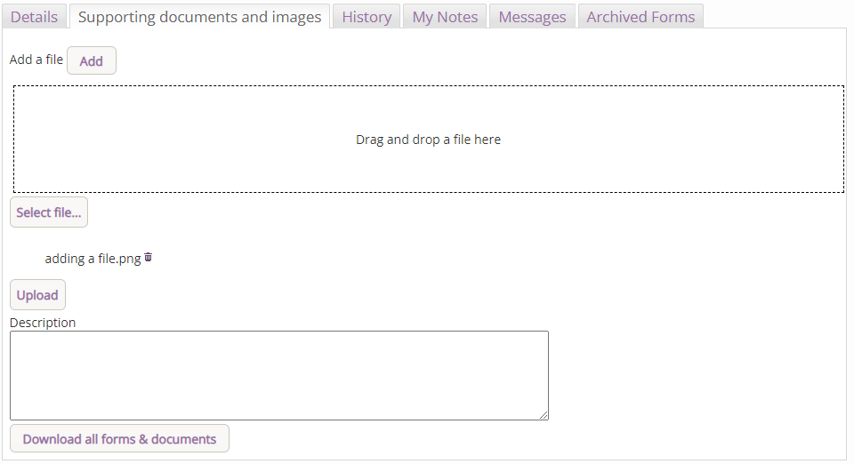
Adding documents
Notes:
Because there is a need for consultation and an archdeacons permission you will need to add supporting documents to the application. This is the same for a Faculty as a List B
Select the supporting documents tab
Click add
Drag and drop or upload
Type a description
Press upload.
Note that the description will stay the same so delete the previous wording and retype as applicable for each new document. Preferred documents are PDF, Word and JPEG. We cannot access Apple files so please convert before uploading.
If you have multiple image please consolidate them into a single Word document and convert to a PDF before uploading.

Slide 16
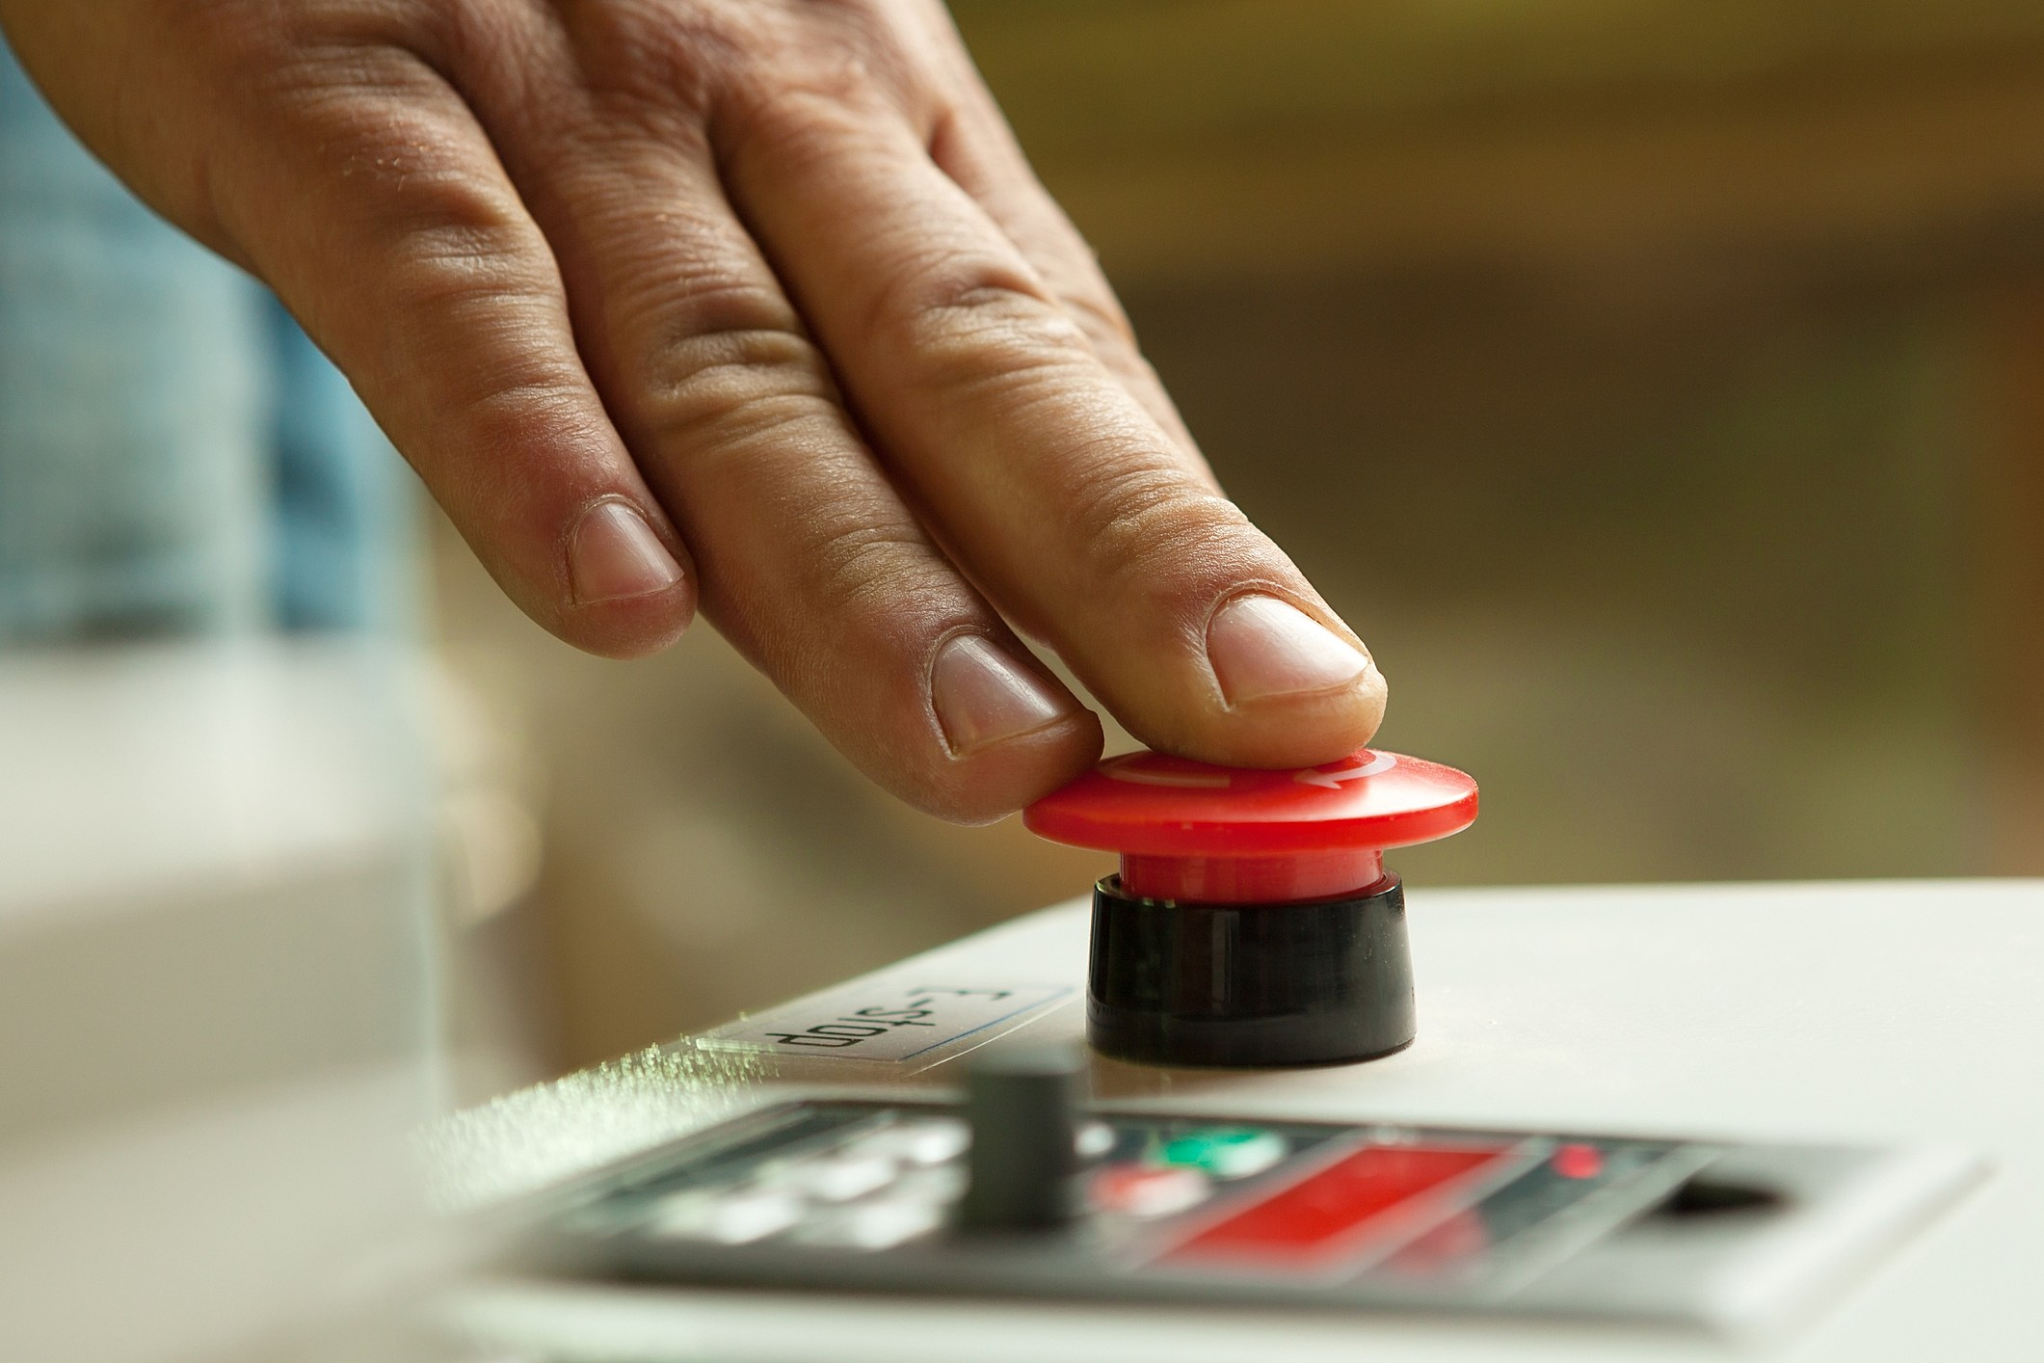
Applying for List B works
Once you feel that your application is ready and you have clicked ‘submit’ on the OFS, the CBT will be able to review your application and supporting documents
The application will either be sent for consultation or reverted pending further information
If the reviewing DAC member feels something is missing the application will be reverted pending further information. If everything is good then the application will be sent to the Archdeacon for determination.
Notes:
Once submitted it does not mean the application cannot be amended. If the CBT does not consider your application ready to progress we will revert it to you and provide details of what else is required. If the CBT considers that the application is ready to progress we will consult relevant member(s) of the DAC for their advice.
If the reviewing member(s) have any queries or concerns we will revert the application to you on the OFS and provide details of the query raised.
Reverting an application allows you to amend or add documents to your application.
Once the Archdeacon has made their determination you will receive an automated email with the Archdeacon’s Written Notice giving details of the application and any specified conditions. At this point you can commence work.

Slide 17
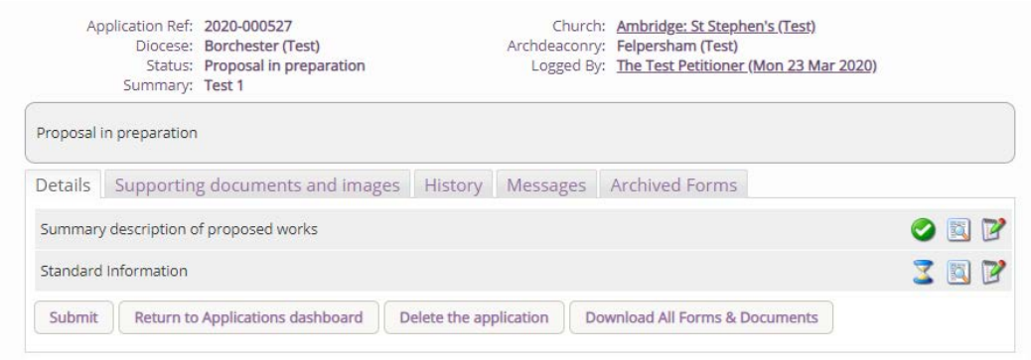
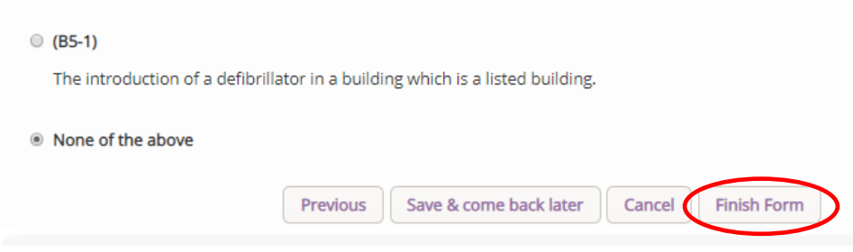
Applying for a Faculty
Starting an application
Notes:
The process for starting a Faculty is the same for starting a List B only this time when presented with the List B options you select ‘None of the above’ then Finish.
Once complete you will be given just two boxes. The first, the summary will already be filled in. The second the Standard Information form will also be pre-populated. It is important to go over this and make sure everything is accurate as often the information will be out of date.
Before submitting it is worth uploading some preliminary documents so that we can have an idea of the proposals and be able to give some more tailored advice.

Slide 18

Applying for a Faculty
Faculty Documents
1. Statement of Significance
2. Statement of Needs
3. Architect’s and Surveyor’s Advice Form (Template Available)
4. Correspondence with Church Insurer
5. Images and Church Layout
6. Specification/Quotation
7. PCC Minutes
Notes:
The basic documents you will need are very similar to that of a list B only with the addition of the statement of significance and need.
This standard list, template forms and links to further guidance can be found on the DAC website.

Slide 19
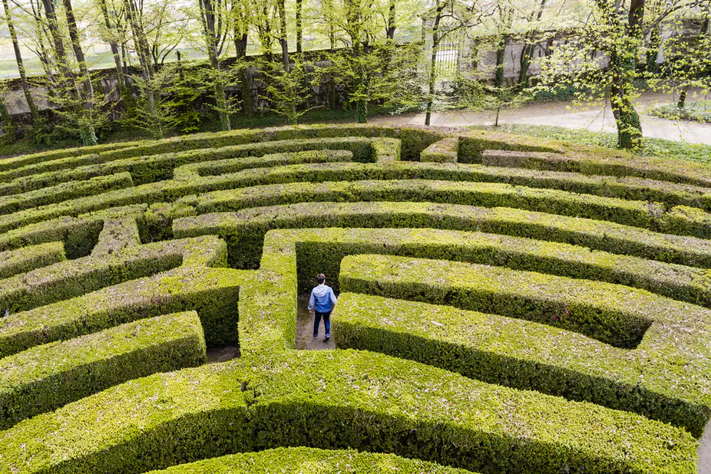
Applying for a Faculty
Why faculty
400,000 listed buildings in England
2.5% Grade I
5.8% Grade II*
Church of England has approximately 12,500 listed buildings
Any Faculty must acknowledge this and seek to maintain or enhance its significance.
All applications are weighed on the basis of benefit versus Harm
The first thing to do before even starting a Faculty is to populate a statement of significance and need.
Notes:
Applying for a Faculty is not always a straight forward process. It is a legal process that has many checks and balances in order to protect the building and the PCC as well.
There are around 400,000 listed buildings in England with Grade I just 2.5% of that list and Grade II* 5.8%. Of those the church of England churches represent around 12,500 buildings.
Listing demonstrates a building’s importance and also places certain protections and obligations to the owners.
Most applications make reasonable proposals but do so in a way that does not respect the building and that is the reason applications falter.
It is important to understand the significance of the building and the benefit for the church. I cannot stress how important and central to an application these documents are. You can have the best idea in the right location but if you cannot demonstrate that it has the least impact on the building or why that impact is needed the application will not go smoothly through the process.

Slide 20

Applying for a Faculty
Stages of a faculty
Initial review
The DAC does not make decisions and cannot grant a faculty
Pre-formal consultation (30 days approximately)
Review of pre-formal consultation feedback
It is a offence to carry out works to a listed building without the proper consent. This includes works that deviate from the faculty permission granted
Formal consultation (42days maximum with the potential of a 21 day re-consultation)
Review of formal consultation
Notification of Advice issued
You do not actually apply (petition) for a faculty until the public notice is posted and the application is sent to the Chancellor
Public notice displayed
Chancellor’s determination
Faculty Issued
Notes:
This is a simplified set of stages the Faculty application will go through. Depending on the application and what is proposed some stages may be missed out others added in.
At each stage, until the Notification of Advice, the application can be reverted, edited and amended in light of advice give.

Slide 21
Applying for a Faculty
Developing a proposal
Pitfalls
Lack of options appraisal
Lack of understanding of the significance of the church and fixings
An undefined need/benefit (it may be obvious only to you)
Lack of detail/specification in the application
Lack of involvement of an architect or suitably qualified person
Top Tips
Early engagement with DAC and amenity bodies
Consolidated, clear documents (Remember the DAC and amenity bodies may not have seen the church)
Follow relevant guidance from the Church Buildings Council, DAC and others
Don’t carry out any works until you have the right permissions
Don’t assume something cannot be done, you may be surprised
Notes:
What did the Victorians ever do for us?
The DAC cannot design a project for you but it can advise on the benefits and downsides of proposals.
There is nothing worse that receiving a retrospective faculty and you may have to completely undo all the work that was done.
Ecclesiastical exemption is there to benefit the church as a place of worship

Slide 22
Conclusion
Understand what the Online Faculty System is.
Understand the functions of the Online Faculty System.
Understand how to navigate the Online Faculty System.
Start and edit List A, List B and Faculty applications.
Notes:
I hope that you have enjoyed this morning and learnt something. I am going to upload this to the DAC website in our Resources Library so you can revisit this and the notes whenever you need. I shall speak with Anna and if there is a way I will try and get the presentation to you via email.
If you have any questions after this morning or need help please do send us an email.

Slide 23
Useful Links and Contacts
Church Buildings Team: DAC@salisbury.anglican.org
Registry: Registry@salisbury.anglican.org
Parish Support: Parishsupport@salisbury.anglican.org
Church Buildings Team Website: https://www.salisbury.anglican.org/parishes/dac
Diocesan QI scheme: https://www.salisbury.anglican.org/parishes/dac/quinquennial-inspections
Relevant legislation (including schedule 1 List and B): https://www.salisbury.anglican.org/parishes/dac/faculty-jurisdiction-ecclesiastical-exemption
Churchcare Website: https://www.churchofengland.org/resources/churchcare/church-buildings-council
Parish Buying: https://www.parishbuying.org.uk/

