Slide 1


‘Bringing the Vision Alive’
Andy Wolfe, Deputy Chief Education Officer
Church of England
@mrawolfe
Dioceses of Durham & Newcastle
Future Leaders Conference
12 October 2018

Slide 2
#1 Opening Reflection: Resilience in 2 Corinthians

Slide 3
The Church of England Foundation
for Educational Leadership’s mission is:
“To develop inspirational leaders who are called, connected and committed to delivering the Church of England’s vision for education”

Slide 4
Called:
“Leaders who are called can articulate a strong sense of personal vocation to their role, and demonstrate this through their words, actions and decision making, exemplifying a strong moral purpose, confident vision, and ambitious trajectory of improvement. For some, this sense of vocation will be driven by an established or developing faith commitment. They show integrity, honesty and a deep sense of resilience, underpinned by their personal sense of vocation as a leader.”
Notes:
5 minutes
BEFORE GOING TO LUNCH, lets go back to our starting point.
Take a moment on your own to note down:
What has struck you during this morning’s session.
What actions will you take as a consequence
Share with a partner.

Slide 5
Connected:
“Leaders who are connected operate deliberately within communities of practice, positioning themselves within positive relationships that sustain and encourage all parties. They embrace interdependence, demonstrate compassion and embody service to others humbly. They create shared identity within their teams and draw colleagues around a common purpose.”
Notes:
5 minutes
BEFORE GOING TO LUNCH, lets go back to our starting point.
Take a moment on your own to note down:
What has struck you during this morning’s session.
What actions will you take as a consequence
Share with a partner.

Slide 6
Committed:
“Leaders who are committed exude energy and passion in all they do, inspiring confidence and faithfulness in their teams. They are clear about their purpose and resilient in the face of challenge. They take long-term decisions and not easily swayed by short-term changes of policy or procedure. They articulate a sense of mission in their approach to education to which they draw others, and are committed to the flourishing of their pupils and colleagues.”
Notes:
5 minutes
BEFORE GOING TO LUNCH, lets go back to our starting point.
Take a moment on your own to note down:
What has struck you during this morning’s session.
What actions will you take as a consequence
Share with a partner.

Slide 7
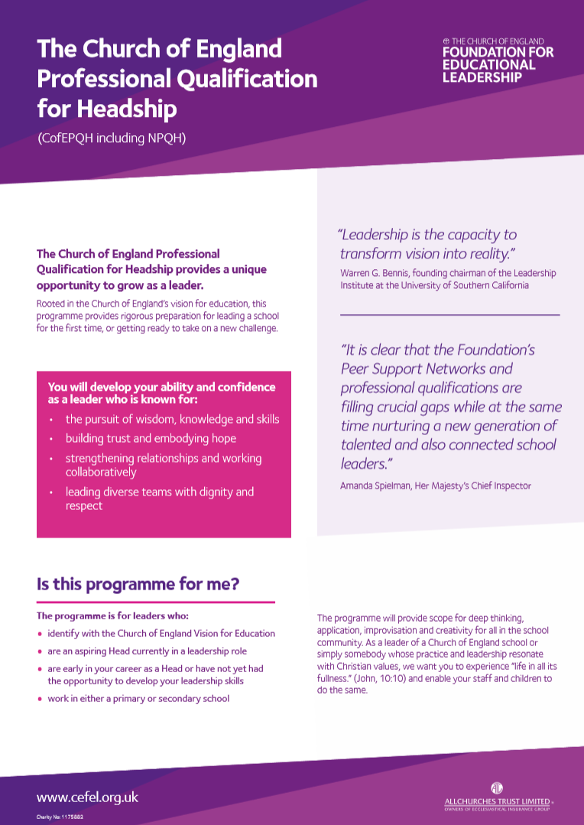
Getting Involved 2018/19
CofEPQH – recruiting now for March 2019 start
National Secondary Leadership Network – 15 November launch

Slide 8
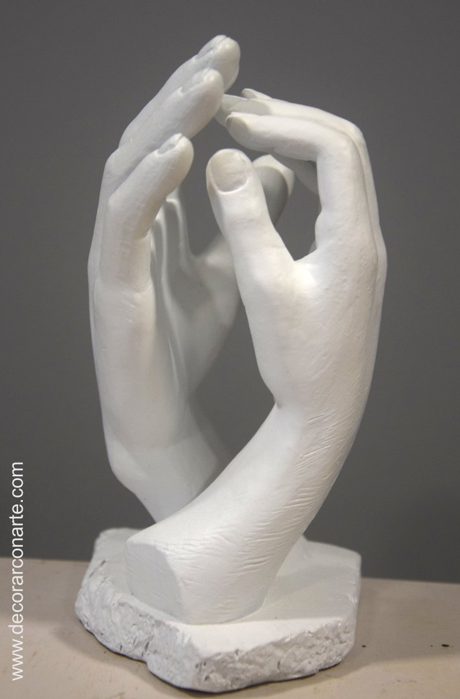
“Vision is a picture of the future that produces passion.”

Slide 9

‘Deeply Christian, Serving the Common Good’ – published Autumn 2016
Leadership, Pedagogy and Theology brought together
Clear vision for education for all schools, not just church schools
Educating for life in all its fullness

Slide 10
‘Life in all its fullness’
Educating for Wisdom, Knowledge and Skills
Educating for
Hope and Aspiration
Educating for Community and Living Well Together
Educating for Dignity and Respect

Slide 11
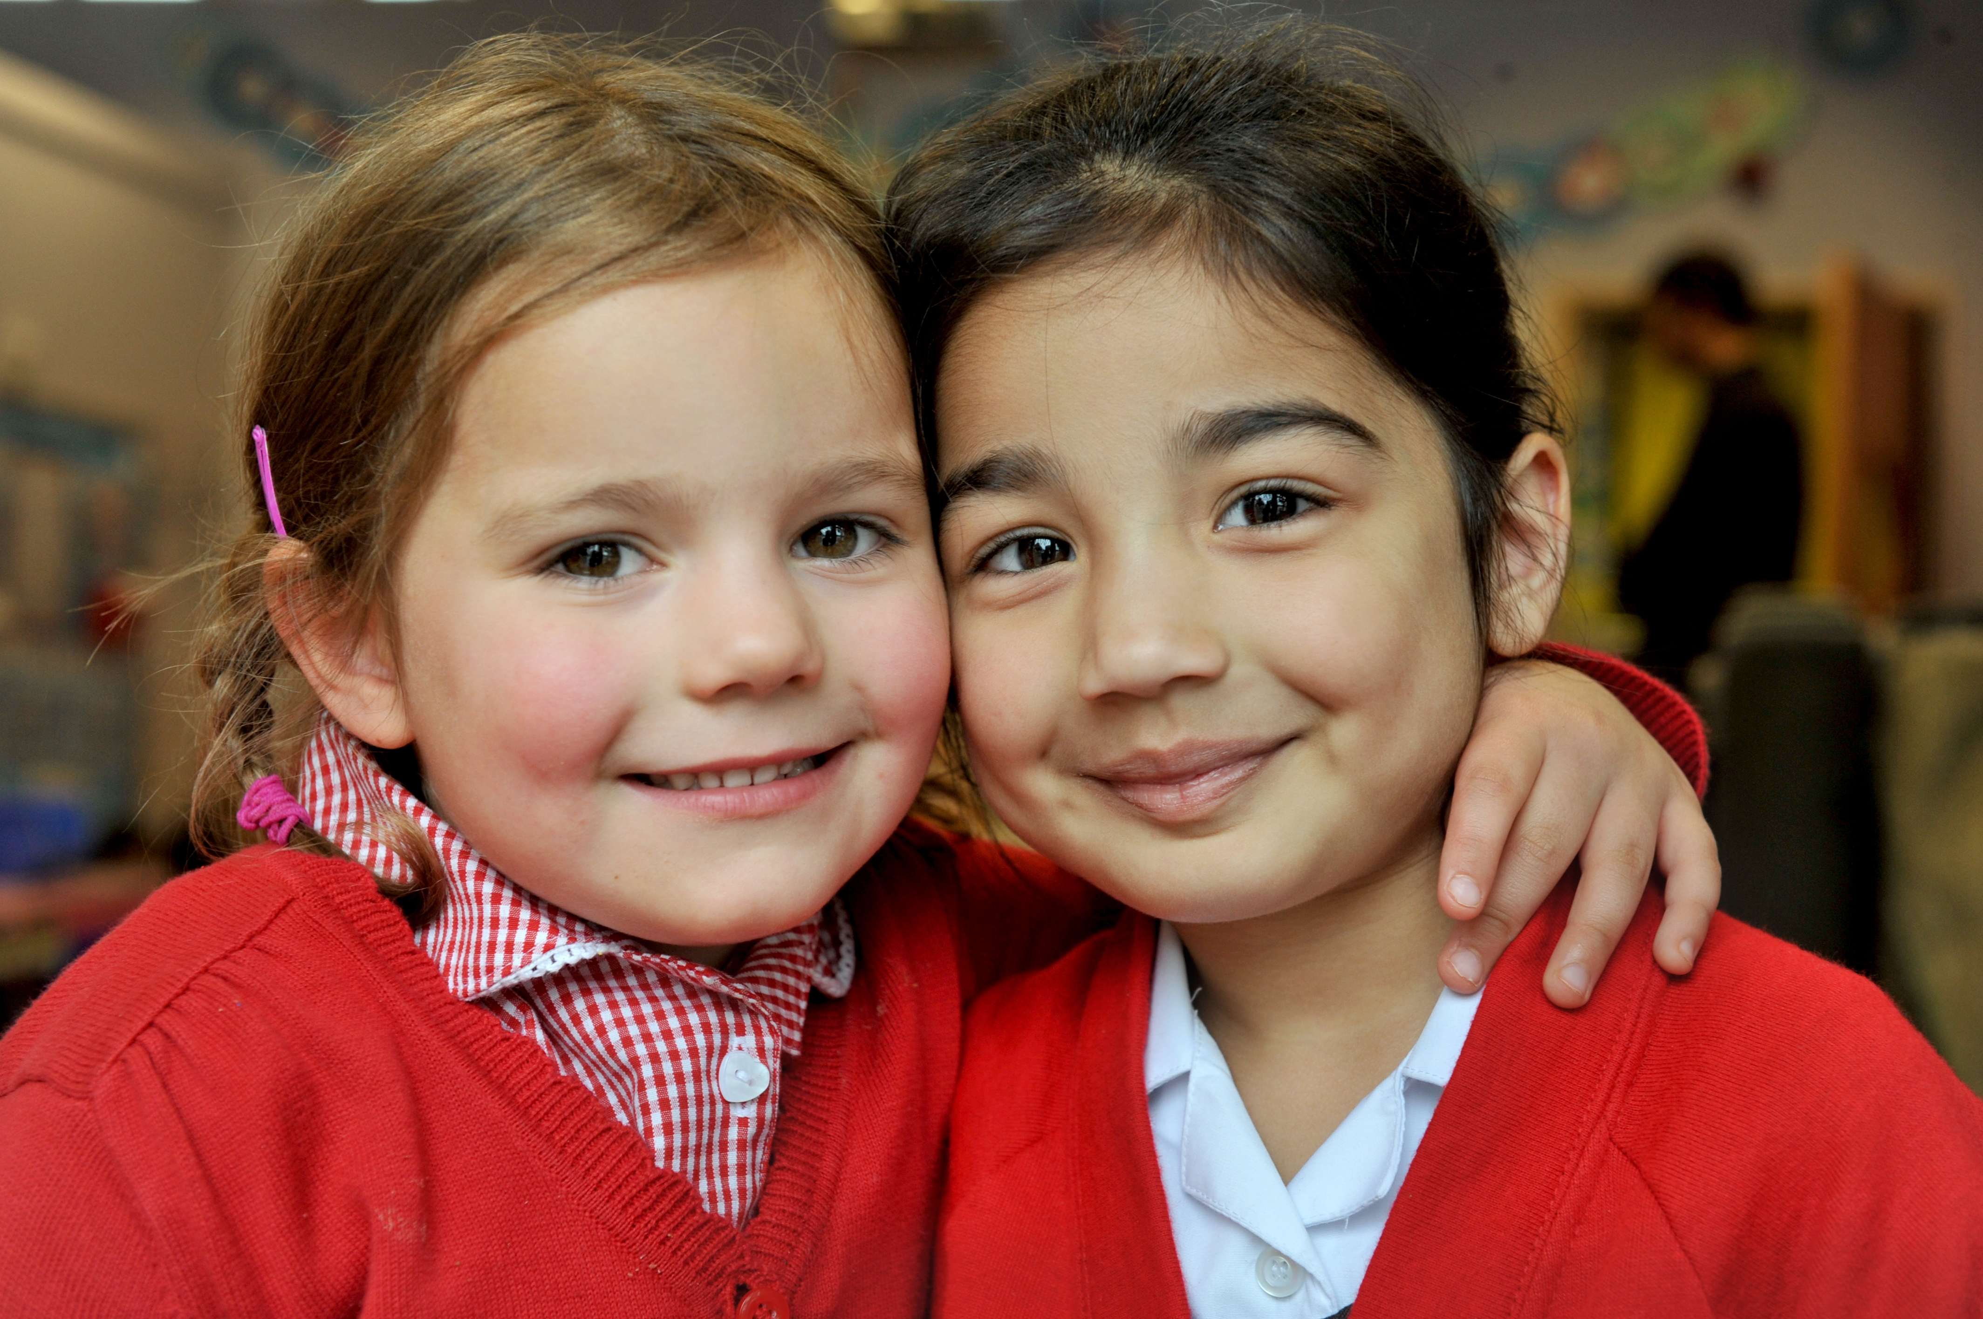
Educating for Wisdom, Knowledge and Skills:
Fostering discipline, confidence and delight in seeking wisdom and knowledge, and fully developing talents in all areas of life.

Slide 12
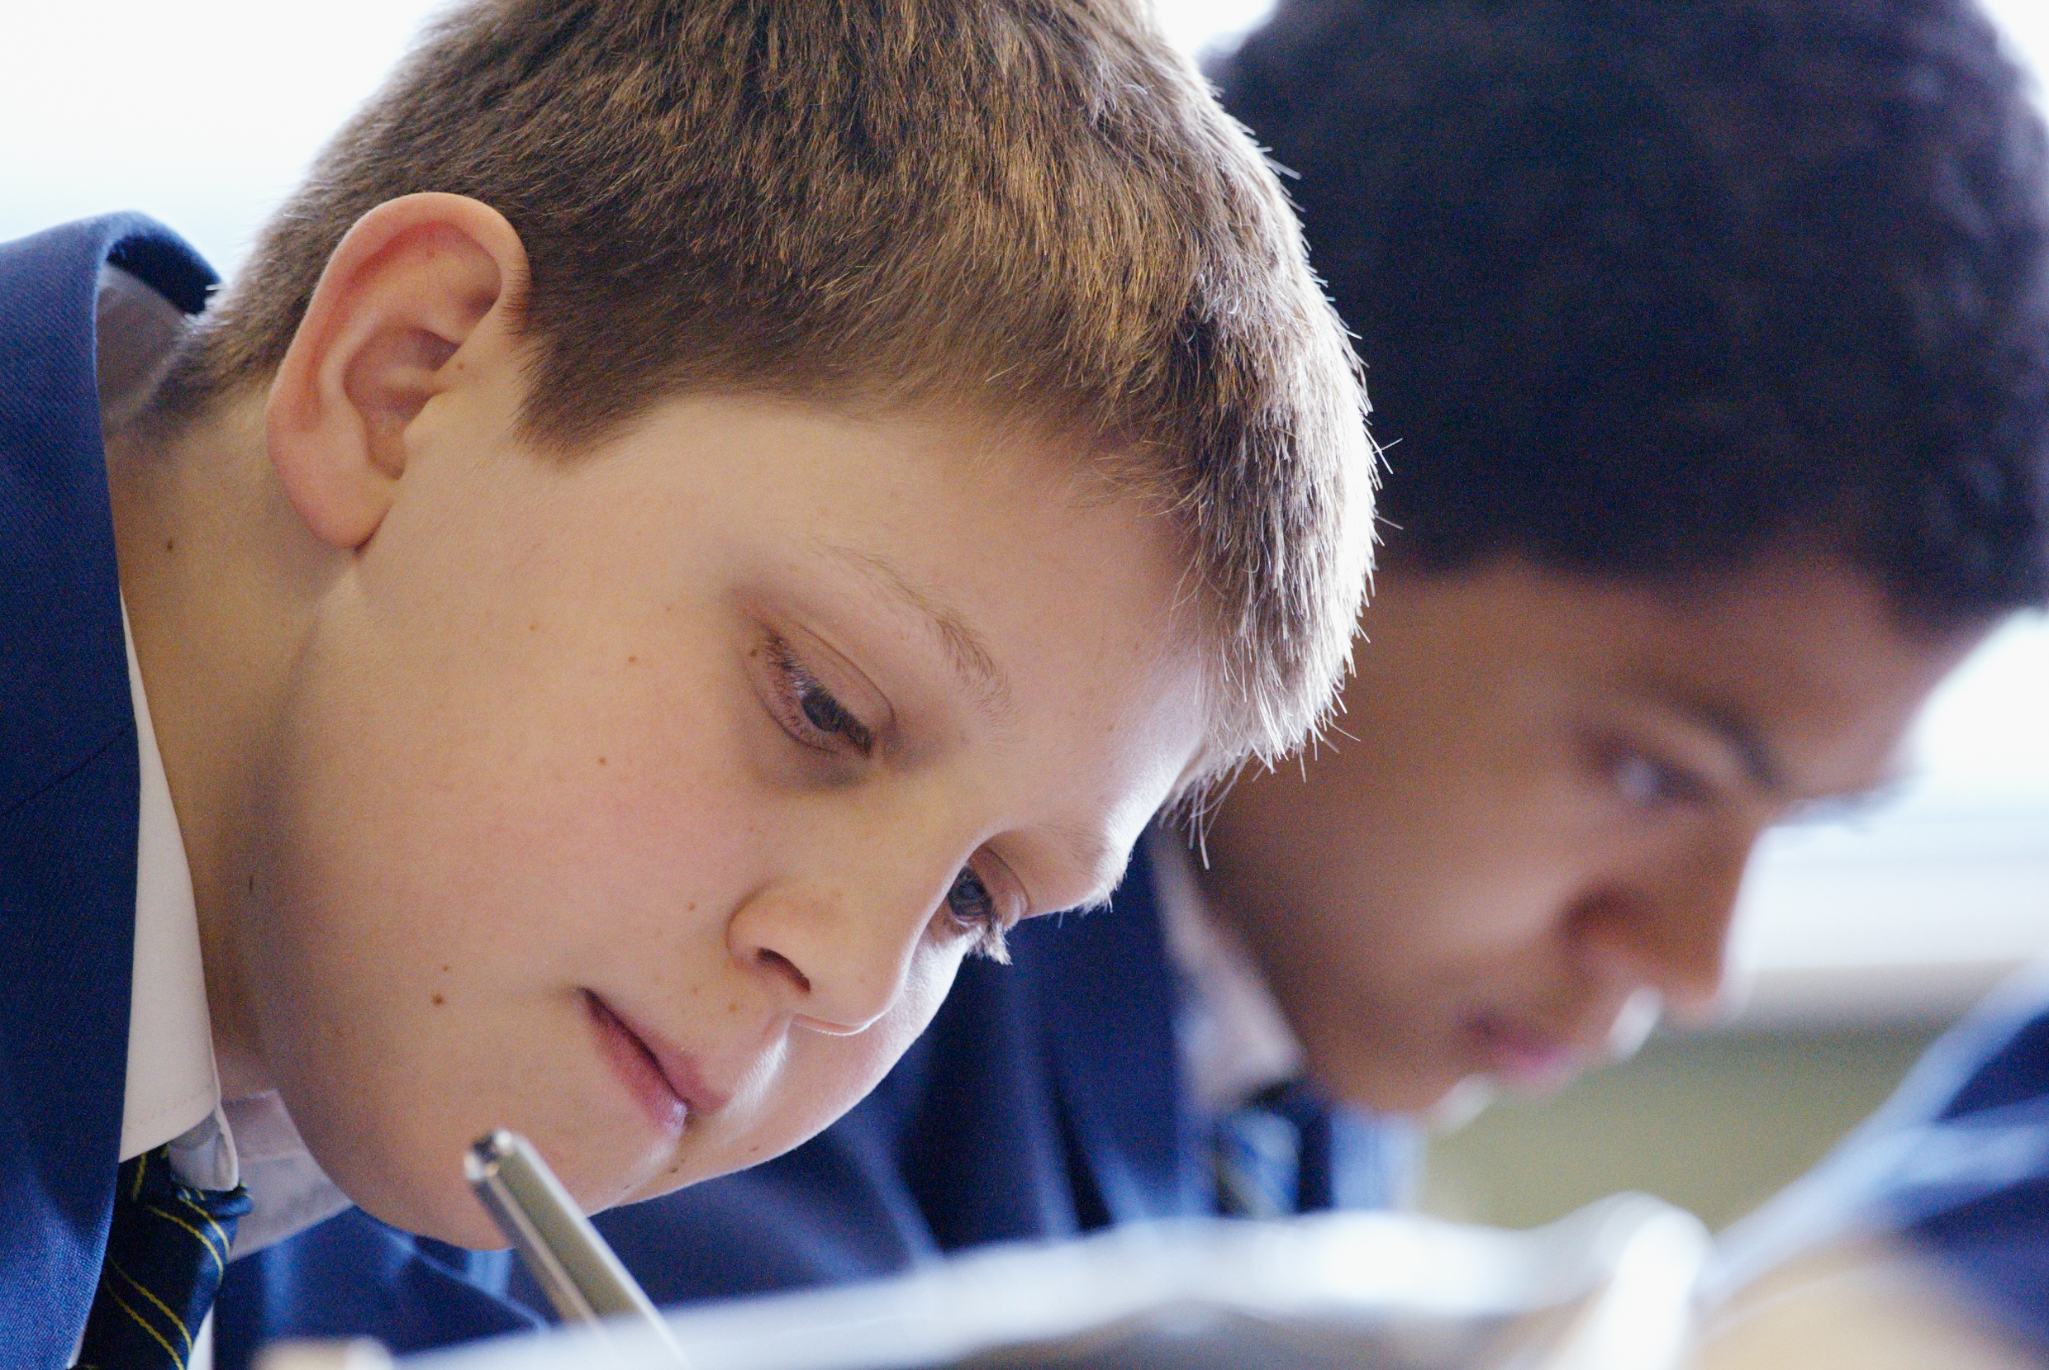
Educating for Hope and Aspiration:
Seeking healing, repair and renewal, coping wisely with things and people going wrong, opening horizons and guiding people into ways of fulfilling them.

Slide 13
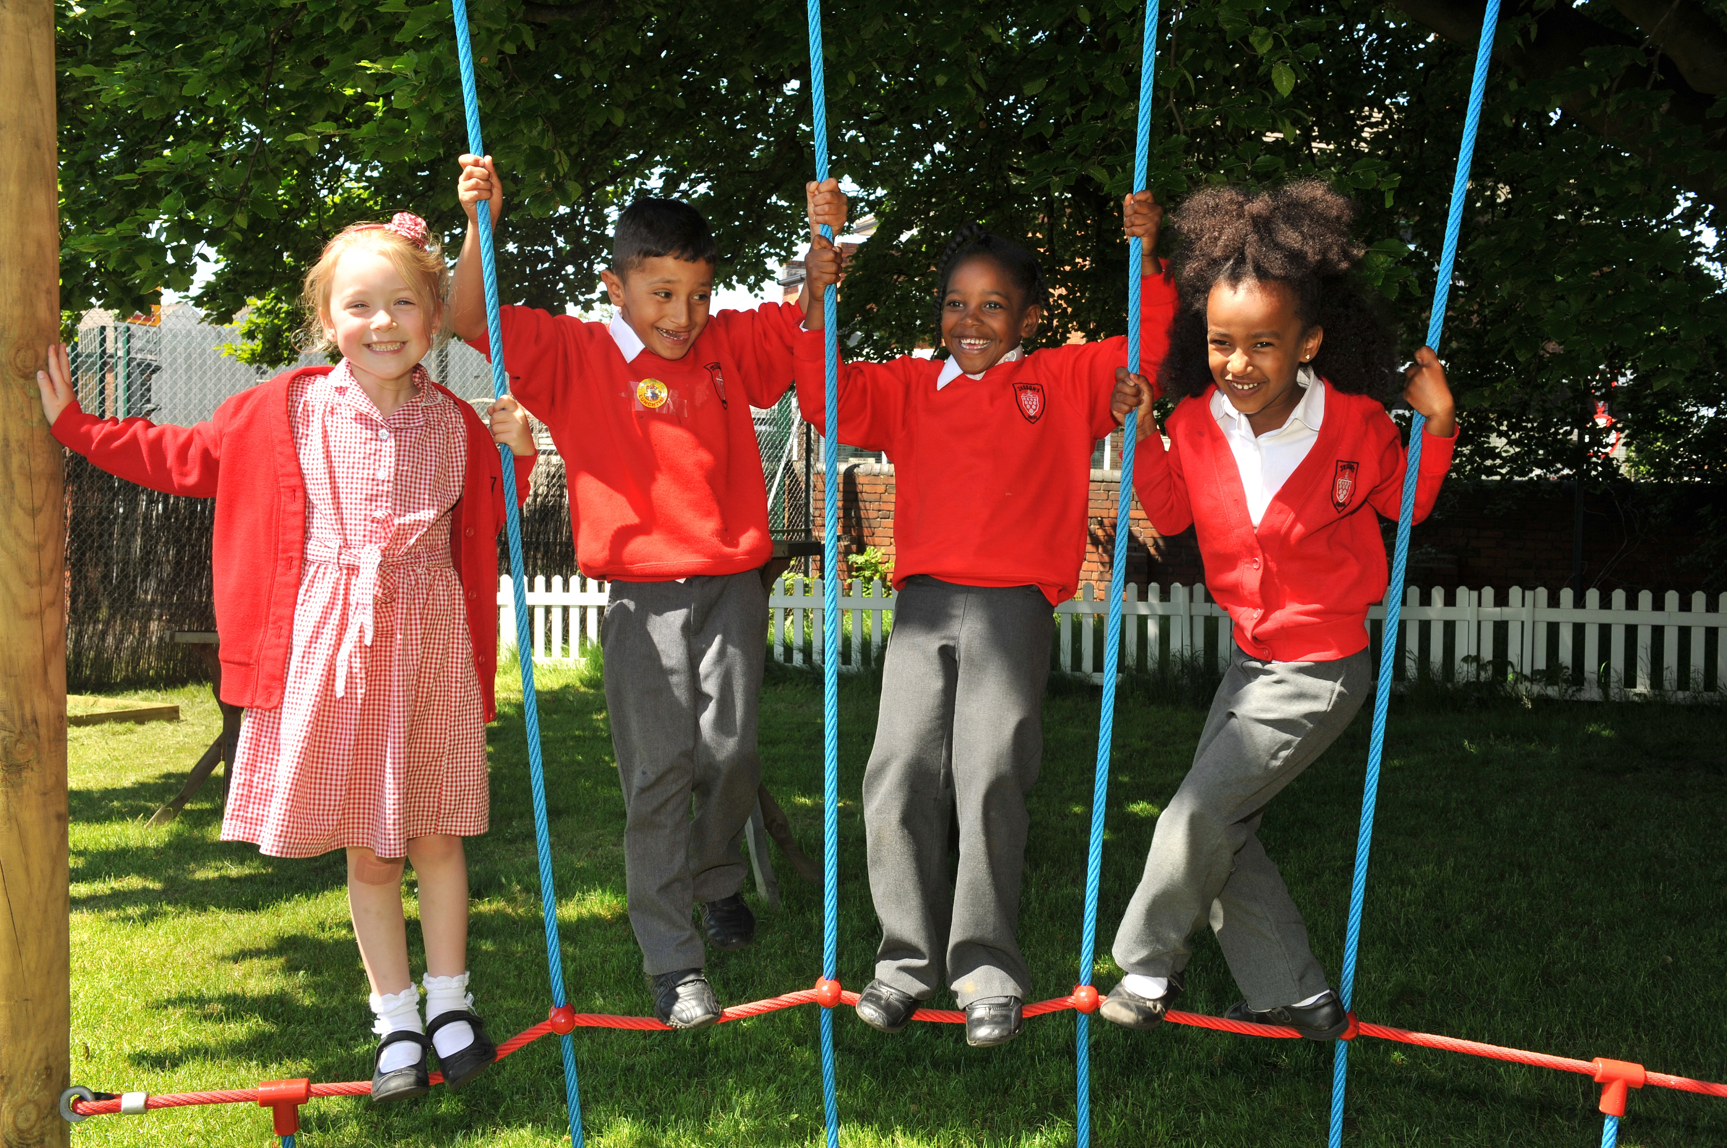
Educating for Community and Living Well Together:
Ensuring a core focus on relationships, participation in communities and the qualities of character that enable people to flourish together.

Slide 14
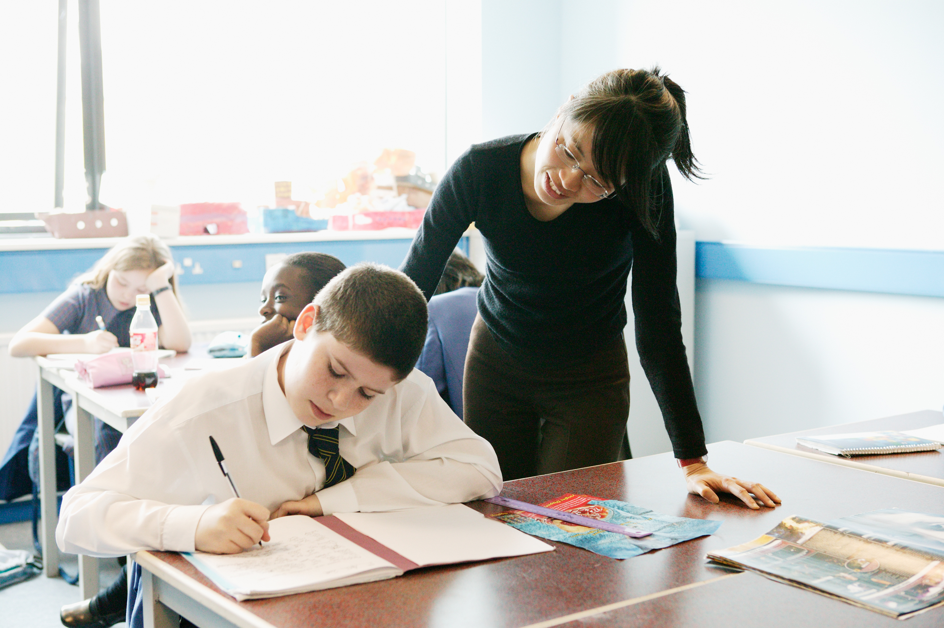
Educating for
Dignity and Respect:
Ensuring the basic principle of respect for the value and preciousness of each person, treating each person as a unique individual of inherent worth.

Slide 15

“If the Vision for Education fails to make and sustain meaningful connections between a school’s ethos and its outcomes, it will become nothing more than a deeply eloquent and well-meaning piece of writing…”

Slide 16
“..It must come off the shelf and be brought to life through leaders evaluating its potential impact on every area of day-to-day school life…”

Slide 17
“…This dynamic and enhancing connection between ethos and outcomes is what we mean by ‘Bringing the Vision Alive.’”

Slide 18
How can we evaluate the prevailing educational narratives?
The importance of teaching (2010)
Schools that work for everyone (2016)
Every Child Matters (2003)
Educational Excellence Everywhere (2016)
Your child, your schools, our future (2009)

Slide 19
How can we evaluate the prevailing educational narratives?
‘A building with 4 walls and tomorrow inside’
‘Building a better world, one student at a time’
Learners Today. Leaders Tomorrow.
Imagine greatness. Knowledge is Power
‘Be safe. Be Kind. Be smart’

Slide 20
How can we evaluate the prevailing educational narratives?
Narrowing the horizons of learning – keeping it tight until May in Year 6
Every percentage point counts
Your child? Our unit of economic capital
Their results? My job.
Most children matter, some matter more than others

Slide 21
Thin Narratives | Thick Narratives
Utilitarian/ Instrumentalist | Wisdom, Knowledge and Skills (for living well)
Competitive | Hope and Aspiration (through forgiveness and grace)
Individualistic | Community and Living Well Together (created for life together)
Reductionist | Dignity and Respect (of every person)

Slide 22
Educating for Wisdom, Knowledge and Skills
Utilitarian/ Instrumentalist
Educating for Hope and Aspiration
Competitive
Educating for Community and Living Well Together
Individualistic
Reductionist
Educating for Dignity and Respect

Slide 23
Example Approach:
Educating for Hope

Slide 24

“You cannot swim for new horizons until you have courage to lose sight of the shore”

Slide 25

What kind of horizon…can you still even see it in the storm?

Slide 26

“I lift my eyes up to the mountains, where does my help come from?” (Psalm 121.1)

Slide 27

Is hope a flower pushing through the concrete?

Slide 28
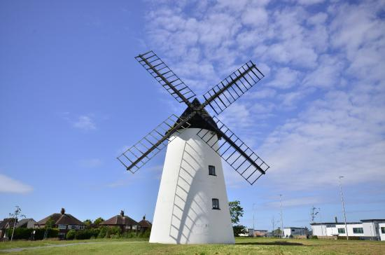
“In the storm do you shelter from the wind, or build a windmill to harness its power?”

Slide 29
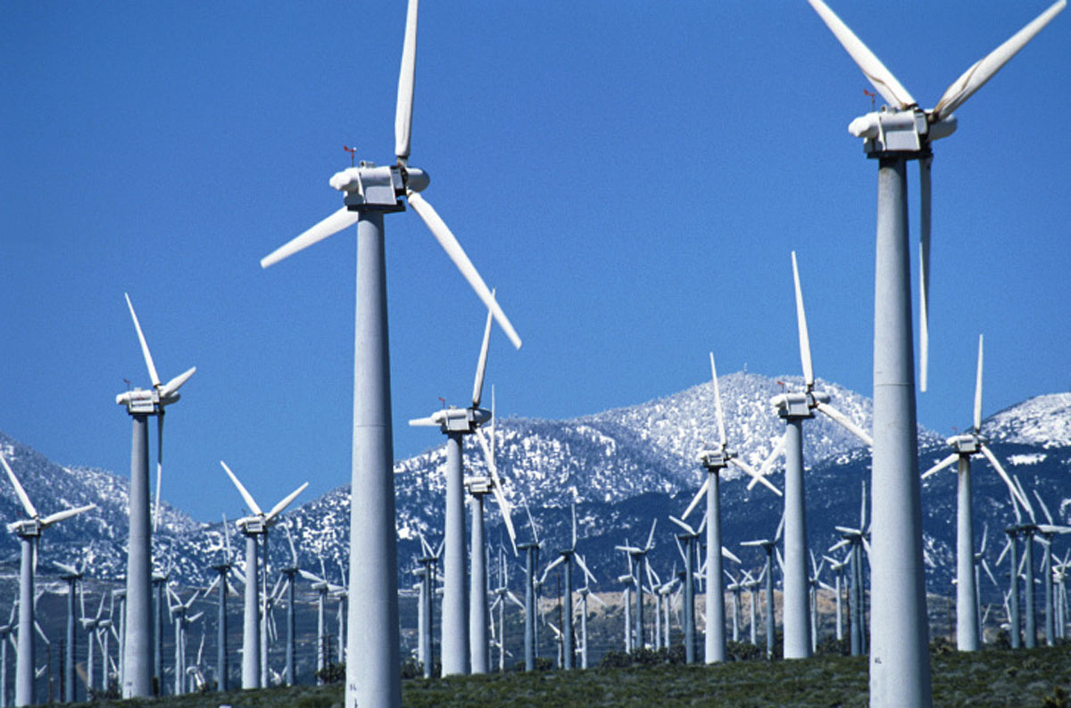
“In the storm do you shelter from the wind, or build a windmill to harness its power?”

Slide 30
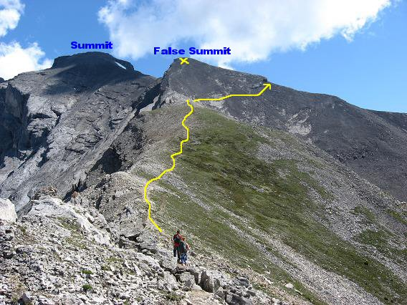
“Which summit are you climbing towards…?
What false summits could dash your hope?”

Slide 31
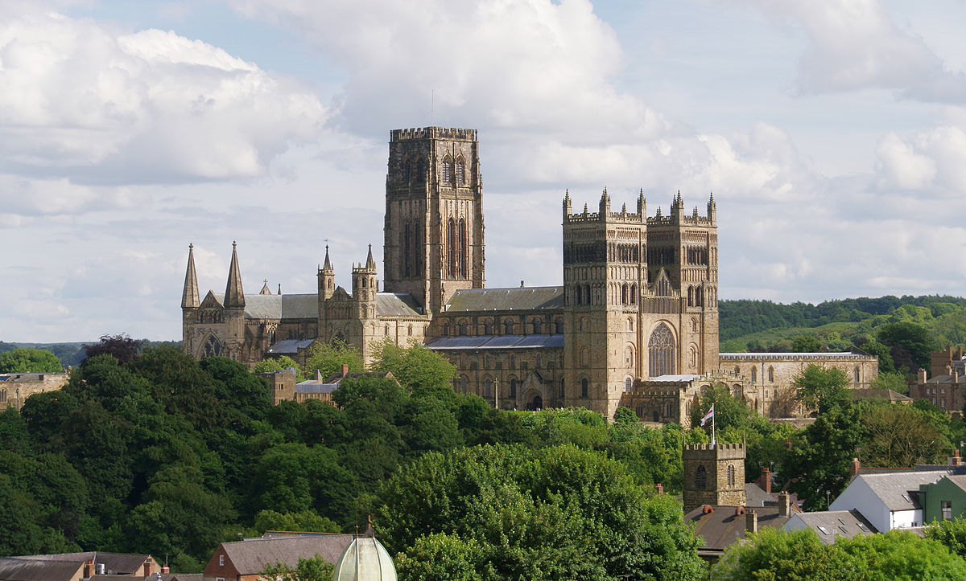
Still build the cathedral…

Slide 32
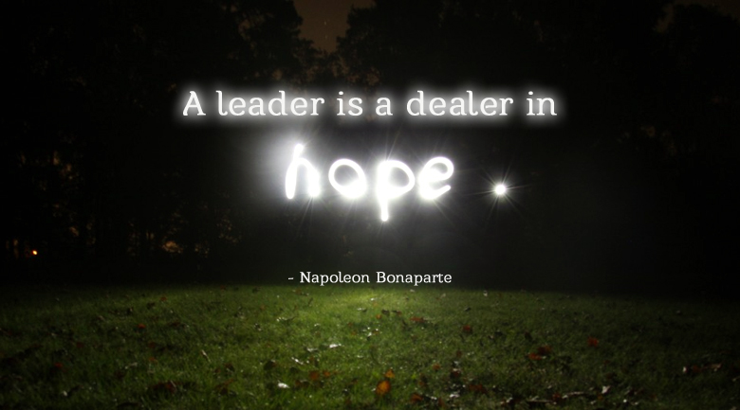

Slide 33
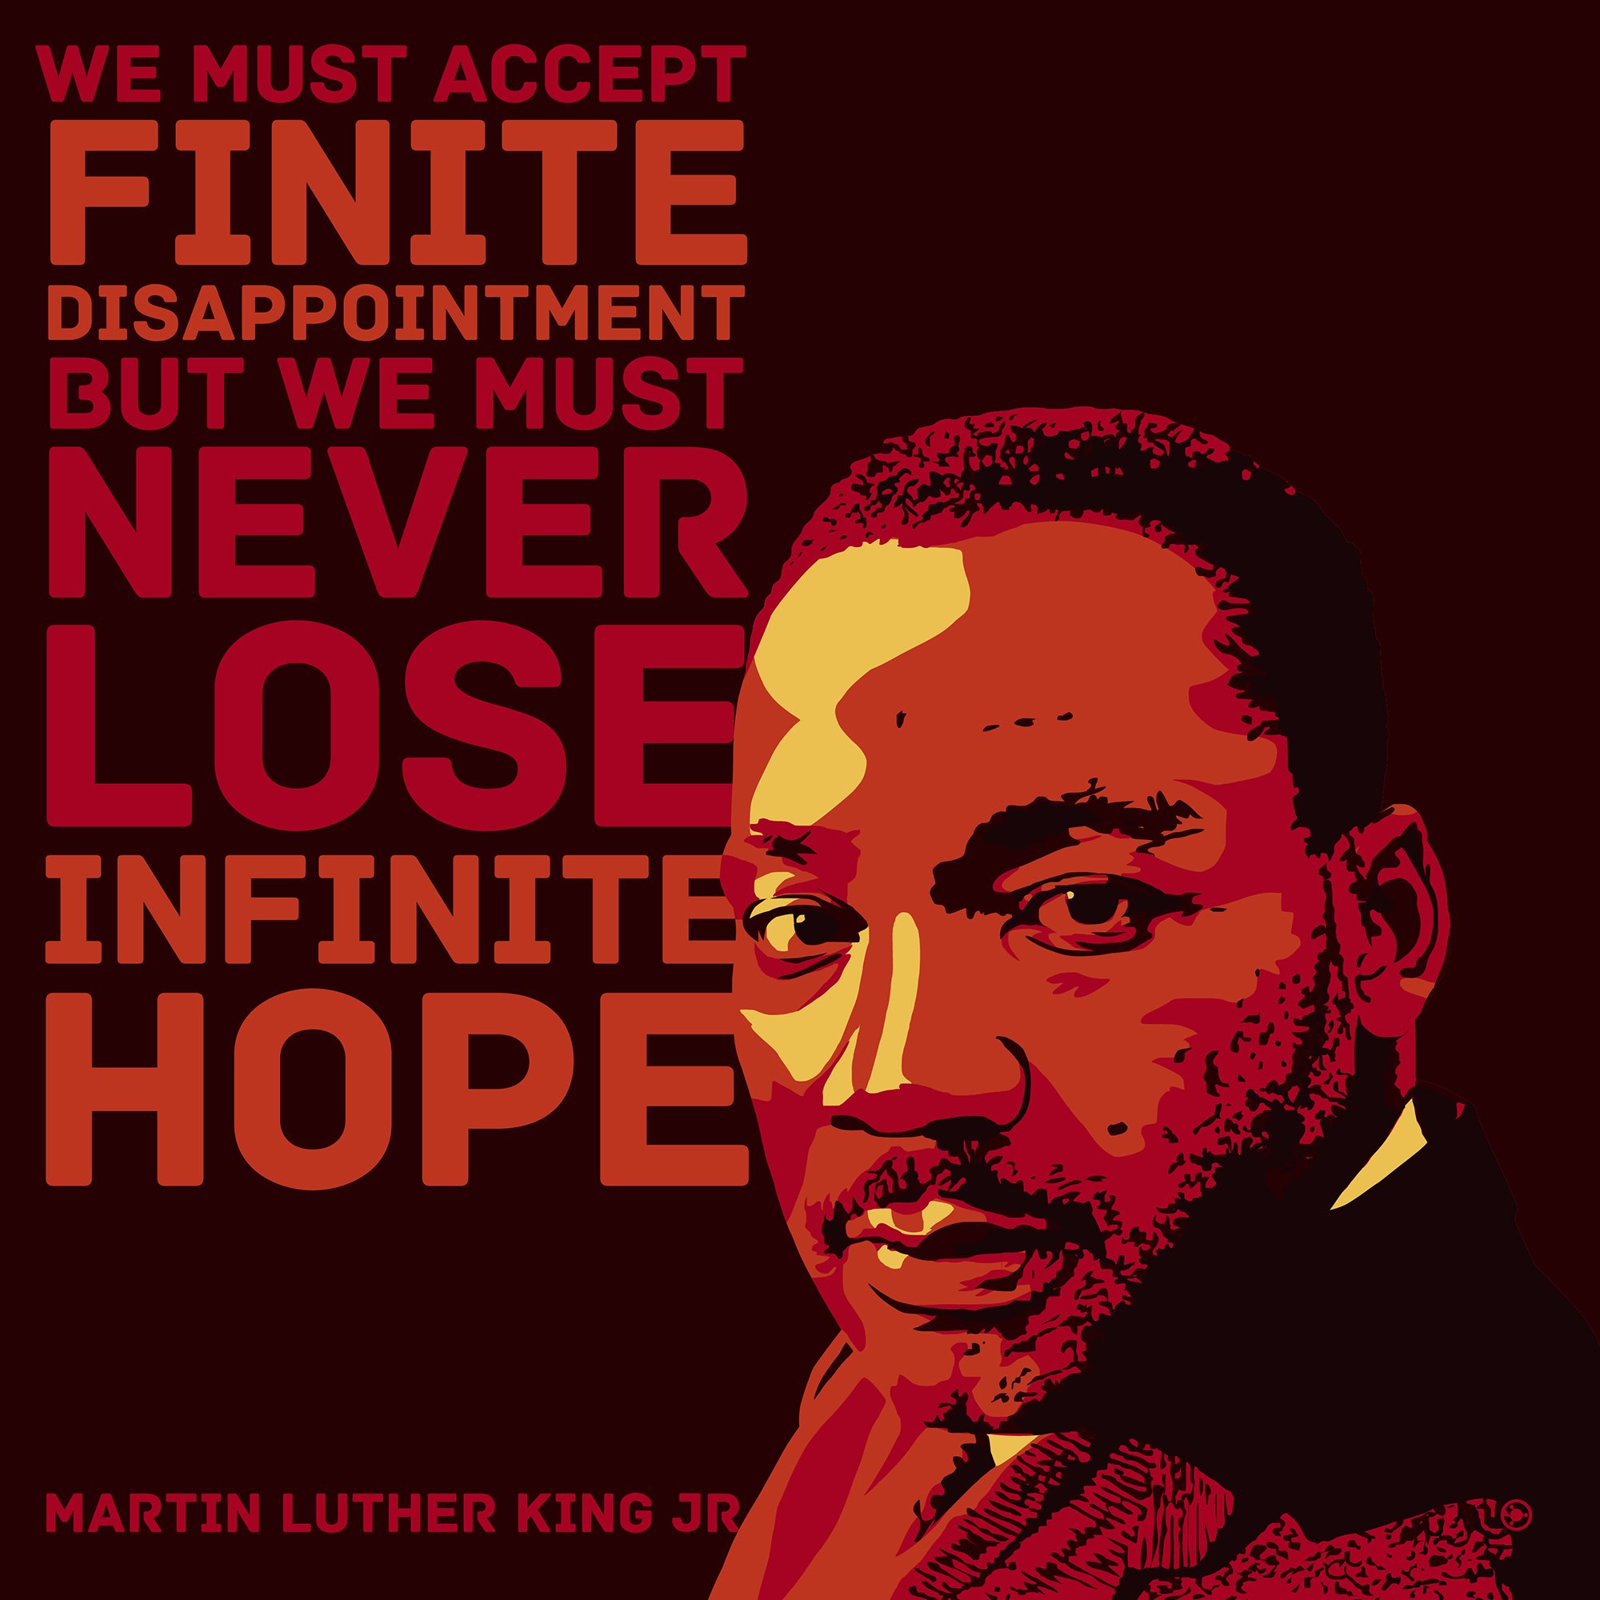

Slide 34
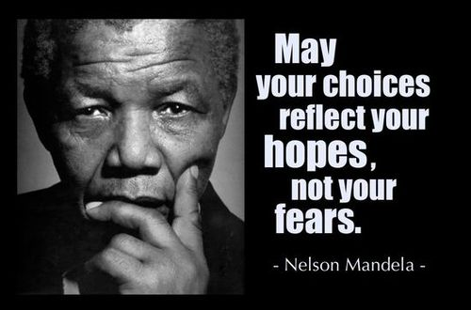

Slide 35
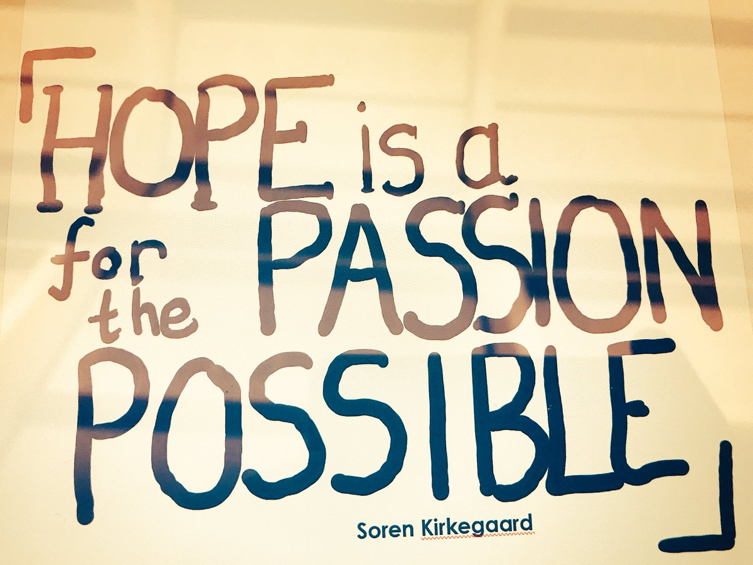

Slide 36


Slide 37
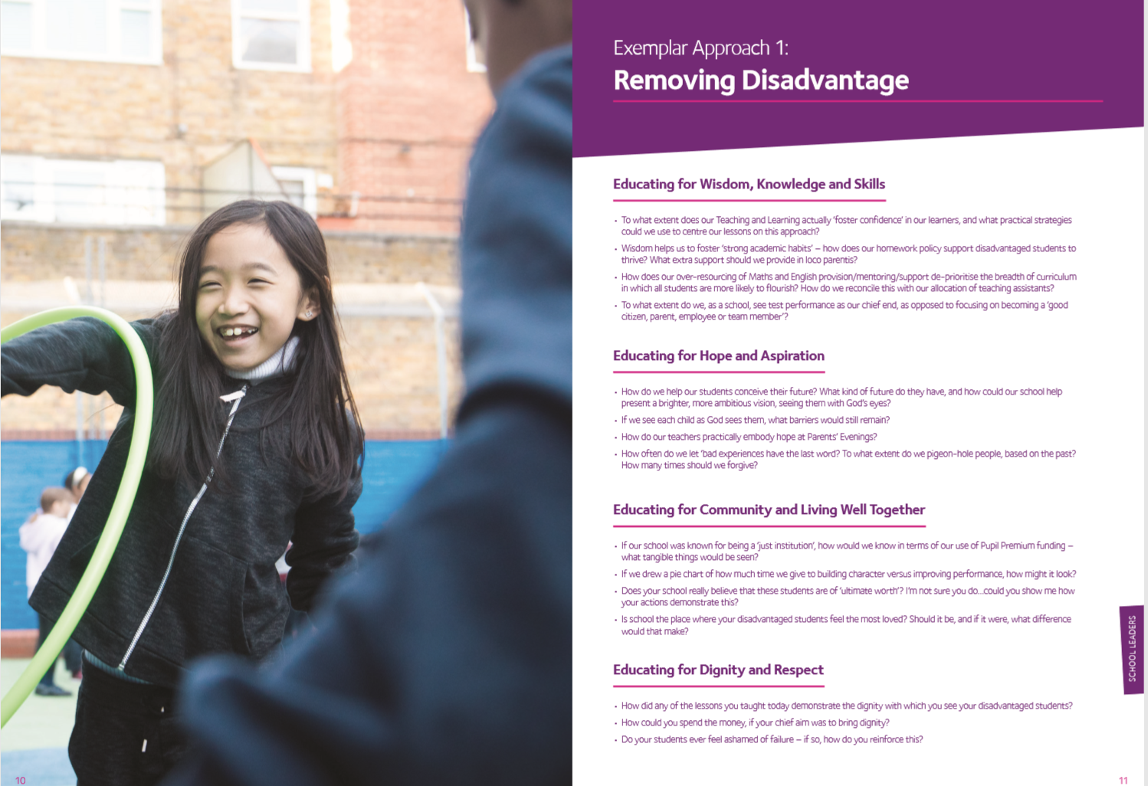
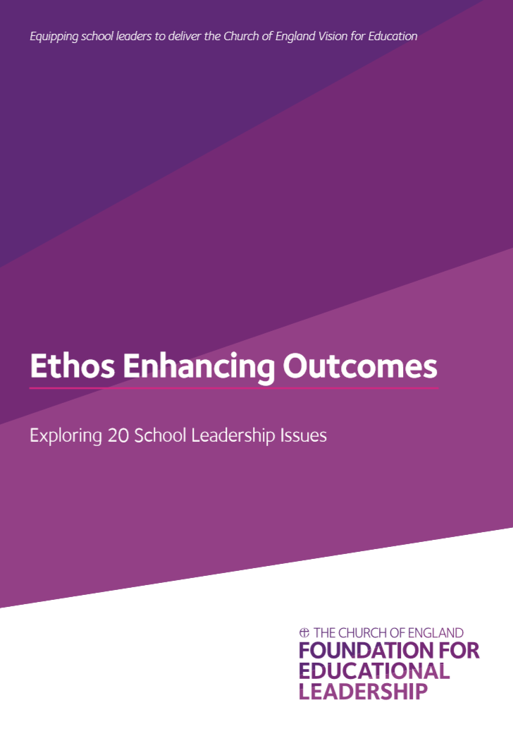
Activity B: Hope in Pedagogy

Slide 38
Rethinking Resilience

Slide 39

“A Christian understanding of resilience is more than simply bouncing back, grit, toughness or ‘stickability’. In our most challenging or painful times, God is at work in us, both as individuals and teams – guiding, strengthening, refining and re-focusing us – as his Holy Spirit helps us to build our character, be filled with hope and to thus bounce back stronger.”

Slide 40


Brene Brown, ‘Daring Greatly’
Notes:
3 minutes
When we focus on daring to develop our character strengths we choose a LIFE GIVING path and allow others to do the same. You are a role model, permission giver, you set the tone of your school, and YOUR EMOTIONAL WELLBEING IMPACTS EVERYBODY ELSE.
Brene Brown , in her book Daring Greatly, talks about being courageous enough to let go of preoccupations which get in they way of leading with authenticity and instead cultivating character strengths and practices which enable you to live, learn, and lead..
Note some of the paradoxes on the slide and acknowledge that we will all have different acheles heals..

Slide 41

And when we struggle…
Richard Rohr, ‘Falling Upward’ (2012)
“The human ego prefers anything, just about anything, to failing…It is not that suffering or failure might happen, or that it will only happen to you if you are bad (which is what religious people often think), or that it will happen to the unfortunate, or to a few in other places, or that you can somehow by cleverness or righteousness avoid it. No, it will happen, and to you…!”
Notes:
3 mins
But for all of us there will be genuine areas of weakness also. Areas where we struggle as leaders. Perhaps in building relationships with certain team members. Or coping with stress- work/life balance, some of us in this room will be doubting our ability to be a head and thinking ‘why did I think I could do this’, some of us have blind spots around self organisation, or maybe staying calm in a crisis, some of us micromanage other people and make them feel less confident than they usually feel when they are around us… we be aware that we are not always kind and compassionate…
In this recommended book, Richard Rohr a Franciscan monk discusses how there is nothing our human egos like less than failure. However, the reality is that we will ALL fail.

Slide 42
And when we struggle…
Richard Rohr, ‘Falling Upward’ (2012)
“…Losing, failing, falling, sin and the suffering that comes from those experiences – all of this is a necessary and even good part of the human journey…
It takes a foundational trust to fall or to fail – and not fall apart. Faith alone holds you while you stand waiting and hoping and trusting.”
Notes:
And it is at these points that we often experience the feeling of trusting God (if we have faith), or if we don’t have faith in God we may experience a sense of perspective and acceptance, a sense of ‘I accept this is happening and I have hope that all will be well’.

Slide 43
“And we boast in the hope of the glory of God. Not only so, but we also glory in our sufferings, because we know that suffering produces perseverance;
perseverance, character; and character, hope. And hope does not put us to shame, because God’s love has been poured out into our hearts through the Holy Spirit, who has been given to us.”
(Romans 5.2-5)
Notes:
To put into perspective..
“A Christian understanding of resilience is more than simply bouncing back, grit, toughness or ‘stickability’. In our most challenging or painful times, God is at work in us, both as individuals and teams – guiding, strengthening, refining and re-focusing us – as his Holy Spirit helps us to build our character, be filled with hope and to thus bounce back stronger.”

Slide 44
Resilience in Staff: Theology
Perseverance
Endurance
Patience
Hypomonen
Translation = ‘to stay under, to remain in place, to get through’

Slide 45

Vision
Trust
Value
Joy
Sustaining Momentum and Building Teams –
Fuel Gauge model
Bishop Paul Williams

Slide 46
Vision
Trust
Value
Joy
Sustaining Momentum and Building Teams –
Fuel Gauge model
Bishop Paul Williams

Slide 47
Pedagogical Posture
Hope is a…
Leadership Virtue
Journey of Faith

Slide 48
Hope as Pedagogical Posture
“You cannot swim for new horizons until you have courage to lose sight of the shore”

Slide 49
Hope as Leadership Virtue
What kind of horizon…can you still even see it in the storm?

Slide 50
Hope as Journey of Faith
“I lift my eyes up to the mountains, where does my help come from?” (Psalm 121.1)

Slide 51
Lunch

Slide 52
“If the Vision for Education fails to make and sustain meaningful connections between a school’s ethos and its outcomes, it will become nothing more than a deeply eloquent and well-meaning piece of writing…”

Slide 53
“..It must come off the shelf and be brought to life through leaders evaluating its potential impact on every area of day-to-day school life…”

Slide 54
“…This dynamic and enhancing connection between ethos and outcomes is what we mean by ‘Bringing the Vision Alive.’”

Slide 55
My hope is that the lessons of the Foundation will resonate not just within Anglican schools, but also beyond, supporting improvement right across the system.
One of those lessons, that I certainly hope echoes in schools of all faiths and none, is the Foundation’s affirmation that there should not, indeed cannot, be a trade-off between school ethos and school outcomes.
Amanda Spielman, HMCI, Feb 2018

Slide 56
What outcomes are you trying to improve?
What are the pressures and challenges?
Who defines this journey?
What help could the Vision offer you?
ethos
enhancing
outcomes
How do you define this for your school?
(in a sentence…)
Where does your ethos come from?
What are the commonalities and differences between us?
What difference does it make to your lived reality?

Slide 57
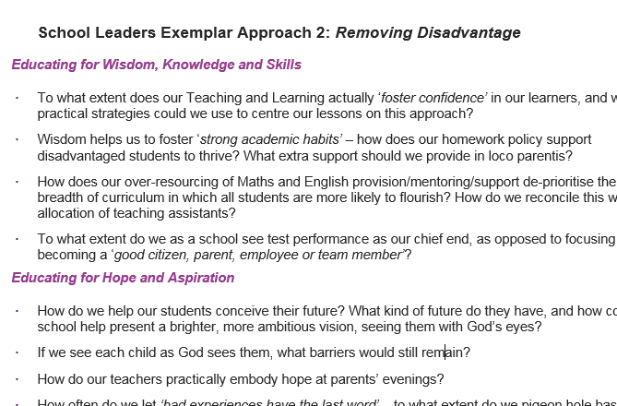
Activity C: Ethos Enhancing Outcomes

Slide 58
Pedagogy: Freedoms and Opportunities
Knowledge
Wisdom
Tension – necessary, symbiotic, empowering?

Slide 59
Pedagogy: Freedoms and Opportunities
Wisdom
Is Vision not simply where we’re headed, but how we see things?
Knowledge
Wisdom

Slide 60

What could this look like for Teaching and Learning?

Slide 61
Learning Plantation | Learning Rainforest
‘A right way to do things’ – set routines – e.g. L.O. on the board every lesson | Nourishing individual talents - high trust/high challenge
Leaders driven by compliance to external voices | Great variety in pedagogy and OK to try new things all the time
T+L focused on what can be examined | If creative approaches deliver, there is high level of autonomy
Data has very high status | Data is part of the picture of learning
Interventions heavily focused on short-term gains | T+L structures are dynamic/organic, aligning T+L to stated school values
Creativity becomes rules – e.g. standardised homework format etc. | Highly personalised CPD

Slide 62
What could this look like for Curriculum Design?

Slide 63
“The International Baccalaureate® aims to develop inquiring, knowledgeable and caring young people who help to create a better and more peaceful world through intercultural understanding and respect.
These programmes encourage students across the world to become active, compassionate and lifelong learners who understand that other people, with their differences, can also be right.
IB learners strive to become inquirers, knowledgeable, thinkers, communicators, principled, open-minded, caring, risk-takers, balanced and reflective.”

Slide 64
Intended curriculum – the required knowledge, skills, understanding (e.g. written down in a specification | Enacted curriculum – what students actually experience as delivered by their teachers (with filters, additions, subtractions etc.)
Assessed curriculum – what students are actually assessed on | Learned curriculum – the knowledge, skills and understanding that students are left with at a later time
Vision/Values – “which kind of learning we value”

Slide 65
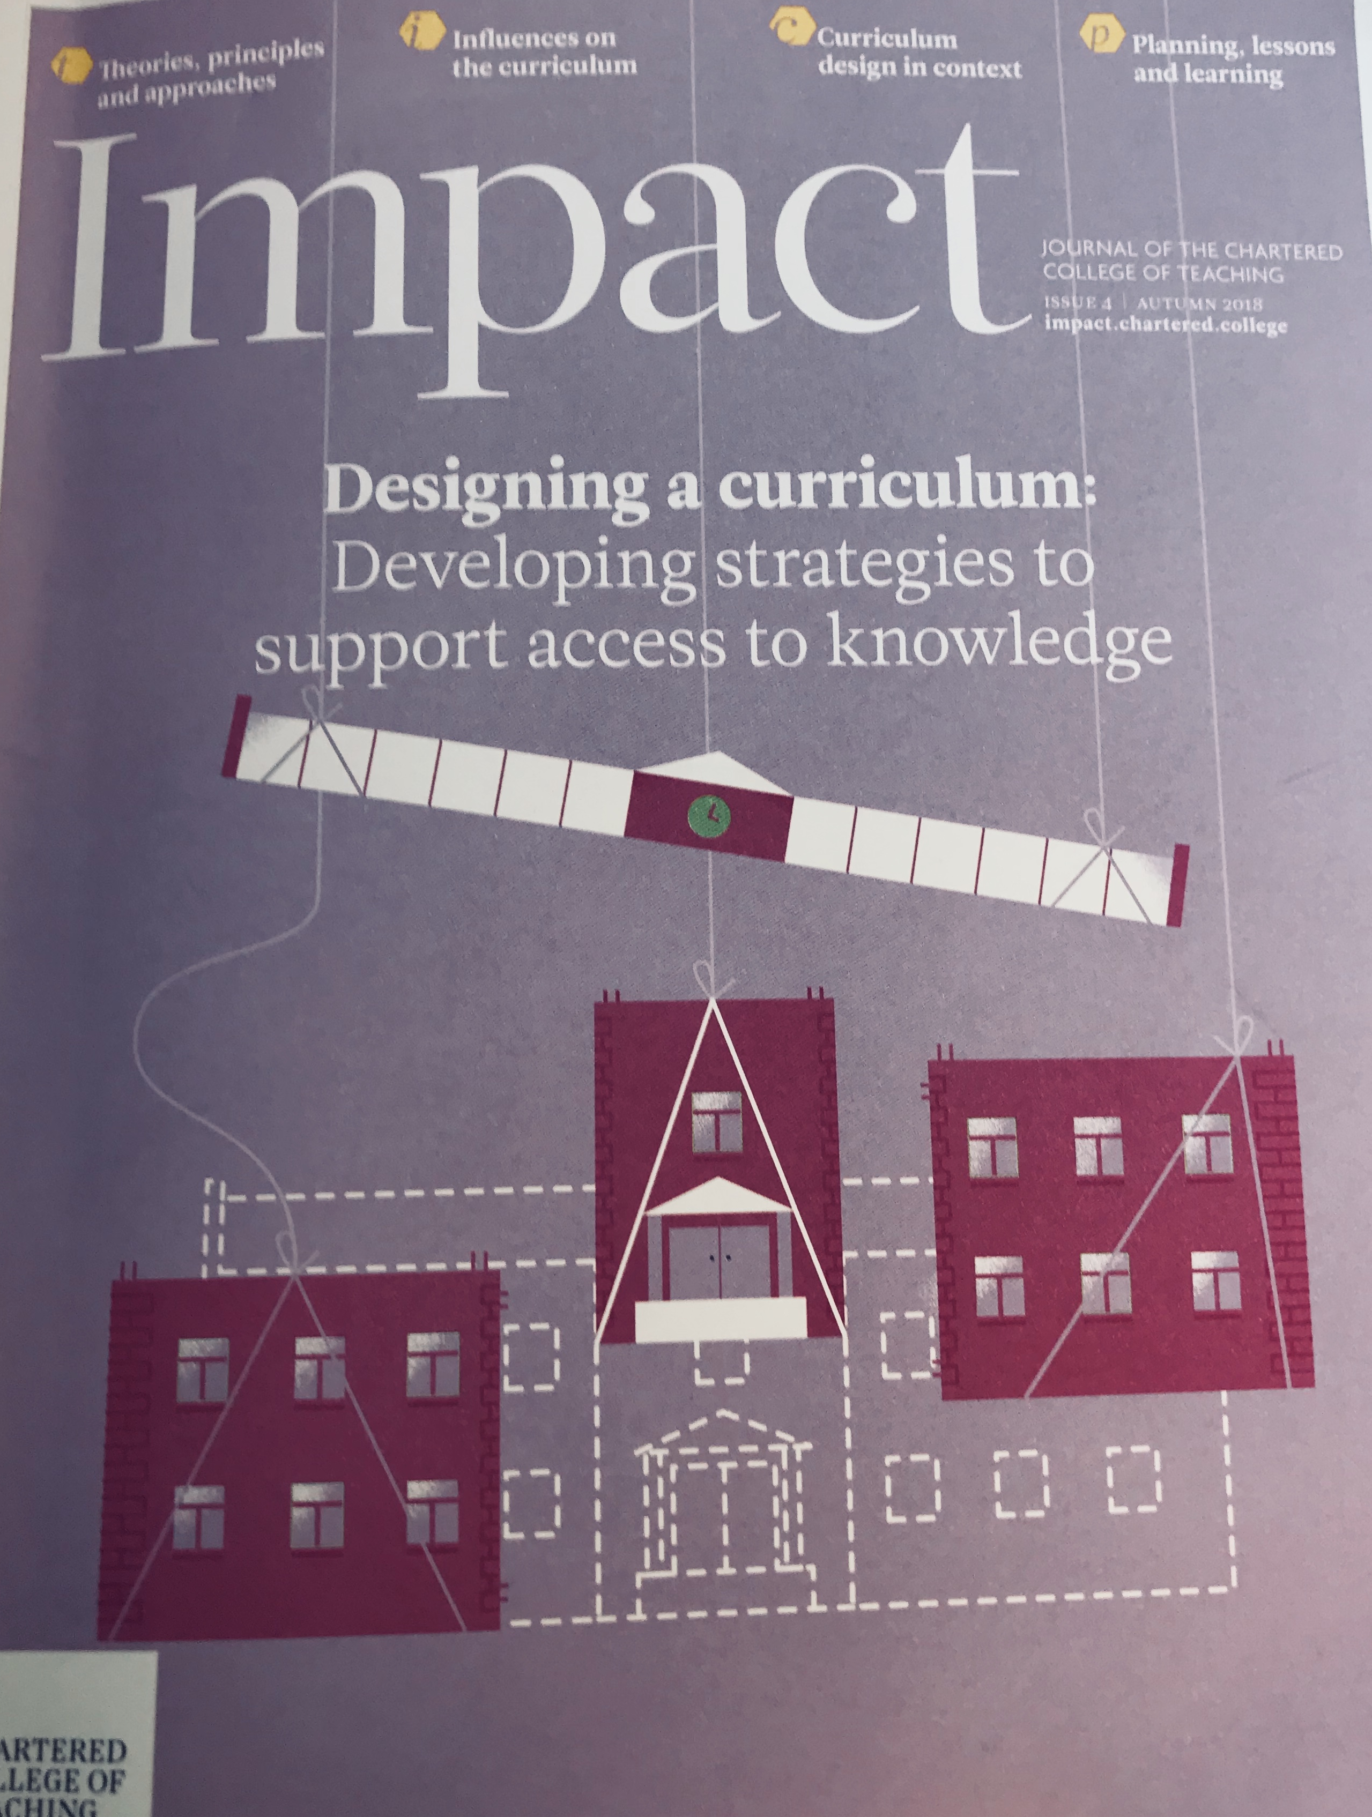
Pitfalls and Possibilities – Prof Michael Young
‘What every child should know’ (ED Hirsch, 2004)
“Any emphasis on ‘knowledge’ is easily interpreted as a form of control and not as a source of emancipation – when, of course, it is potentially both”
(Young, 2018)
‘What are schools for?’ (Young, 2011)
Resource-driven?
Testing driven?
‘Middle-class cultural subsidy’ (Young, 2018)

Slide 66
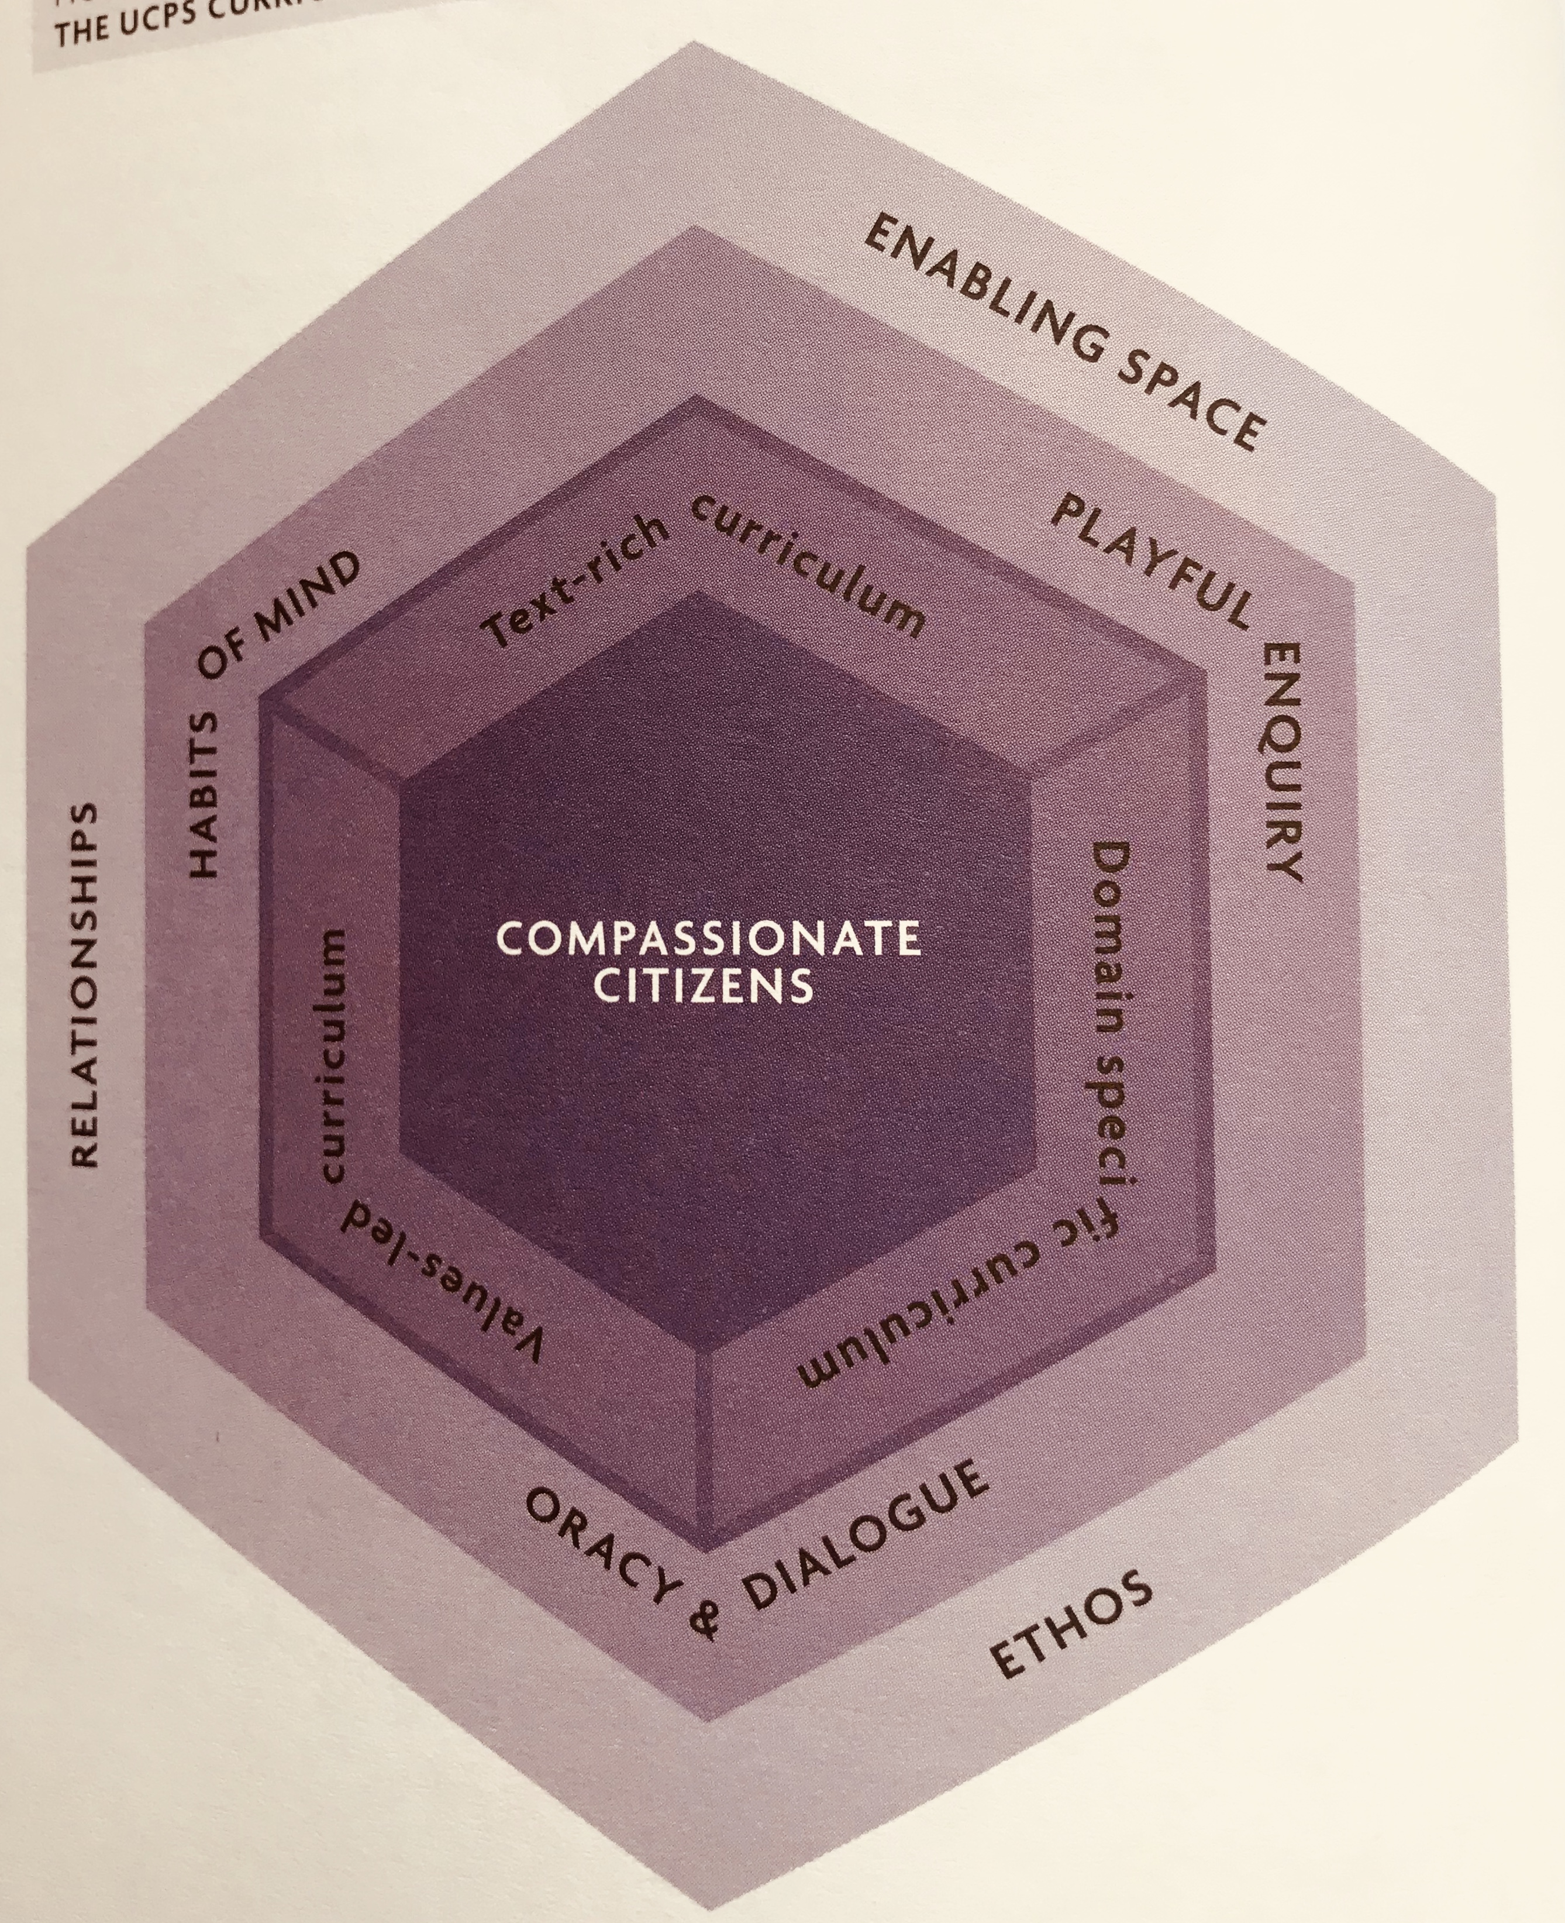
Vision-Driven Curriculum Thinking: ‘Nurturing Compassionate Citizens’ – University of Cambridge Primary School
Core Purpose = Nurture Compassionate Citizens
Golden Threads = Habits of Mind, Dialogue/Oracy, Playful Enquiry
Structure = Values-led, Text-rich, Domain-specific

Slide 67

Curriculum Coherence – Mary Myatt
National/system level – Control vs Coherence
“When the curriculum lacks coherence, it is both harder to teach and harder for students to locate and place their new knowledge”
School leaders – Rationale and Conceptual Rigour
“Curriculum planning is more than the timetable. It is about leaders having thoughtful conversations with colleagues about the curriculum map for the pupils in their school.”
Classroom teachers – Concepts, Knowledge, Inter-disciplinary vs cross-curricular/topics

Slide 68
Leadership of Pedagogy Peer to Peer Activities
Wisdom in Pedagogy: subject mapping experience
Hope in Pedagogy: creating hopeful classrooms
Dignity in Pedagogy: seeing dignity as a precursor to learning

Slide 69
Theology
Leadership
Pedagogy
Can you sum up, in a sentence, what each of these words mean for your school?
How confident might you be talking about each and why?
How might this be the start of an effective coaching conversation around the Vision?

Slide 70
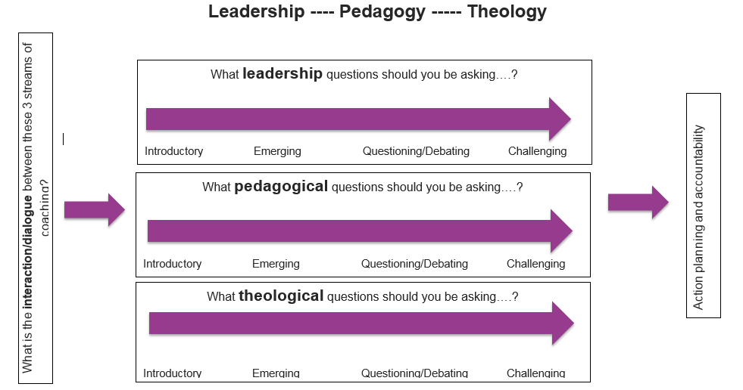

Slide 71
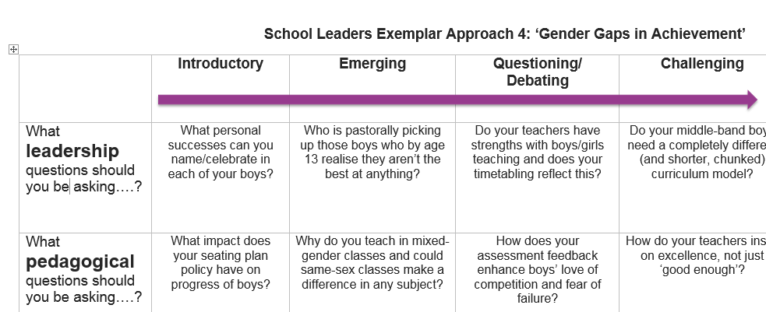
Activity D: Leadership Pedagogy Theology

Slide 72
‘Life in all its fullness’
Educating for Wisdom, Knowledge and Skills
Educating for
Hope and Aspiration
Educating for Community and Living Well Together
Educating for Dignity and Respect

Slide 73
Reflection – 1 Corinthians 13
If I tirelessly teach five outstanding lessons a day, and see my students make excellent progress against their targets, but have not love, I am only a broken window or a wall covered in graffiti.
If I create a perfect climate for learning, have excellent meetings with parents and resolve all the problems of the day through focused toil, but have not love, I am only an uneaten school dinner or a messy office.
If I give all I have to my school and work a 70 hour week, marking, planning, preparing and evaluating and have the most perfect
colour-coded action plan to guide my path, but have not love, I gain nothing.

Slide 74
Reflection – 1 Corinthians 13
Love is patient. Love is kind. It does not envy, it does not boast, it is not proud. It is not rude, it is not self-seeking, it is not easily angered, it keeps no record of wrongs.
Love does not delight in evil but rejoices with the truth. It always protects, always trusts, always hopes, always perseveres. Love never fails.

