Slide 1


THE COMMON FUND
Ensuring we can live out one mission, many places
Notes:
The presentation could be started by showing the short Parish Offer animation: https://youtu.be/IYQykBR9RsU

Slide 2

What is the Common Fund?
The Common Fund is the common pot of money paid into by congregations across the Diocese.
It is used to provide, train and support clergy.
To further the work of the Church in every parish.
To provide important support services for parishes: such as safeguarding, finance, HR and communications
Notes:
The Common Fund is renaming of the diocesan general fund
Launched in September 2019 with new calculation for Indicative Offers to support Parish Offers

Slide 3
Why do we give in this way?
We do not receive any funding from the government.
We are a net contributor to the National Church.
We must raise everything we spend ourselves.

Slide 4
“All the believers were together and had everything in common. They sold property and possessions and gave to everyone in need.“
Acts 2:44

Slide 5
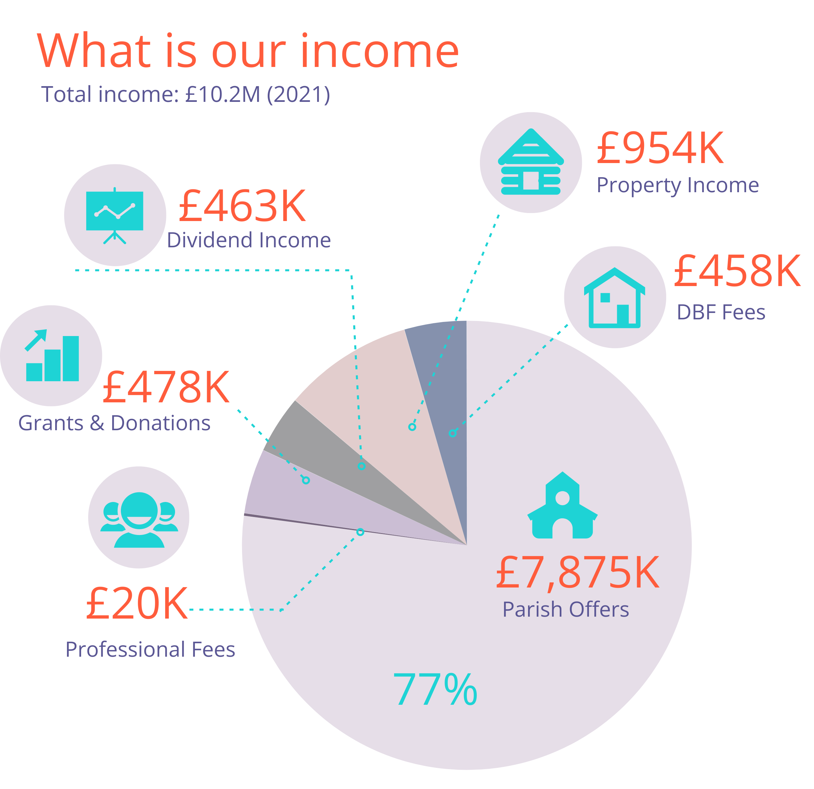
Where does our income come from?
A large percentage comes from the contributions parish’s generously make to the Common Fund.

Slide 6
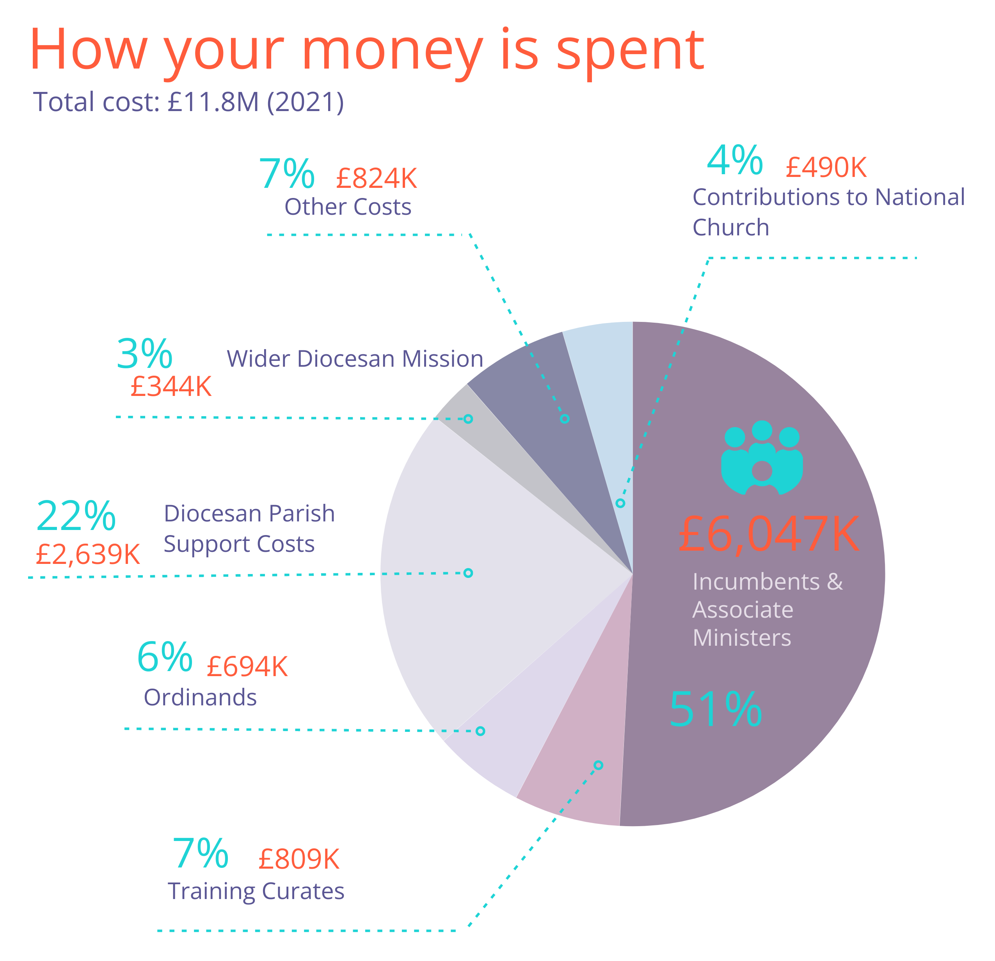
How is your money spent?
Notes:
Wider diocesan mission would include community projects, mission outreach, and work with children and young people.
More can found in the Annual Report on the Diocesan website: www.rochester.anglican.org/about-us/annual-report-and-accounts/

Slide 7
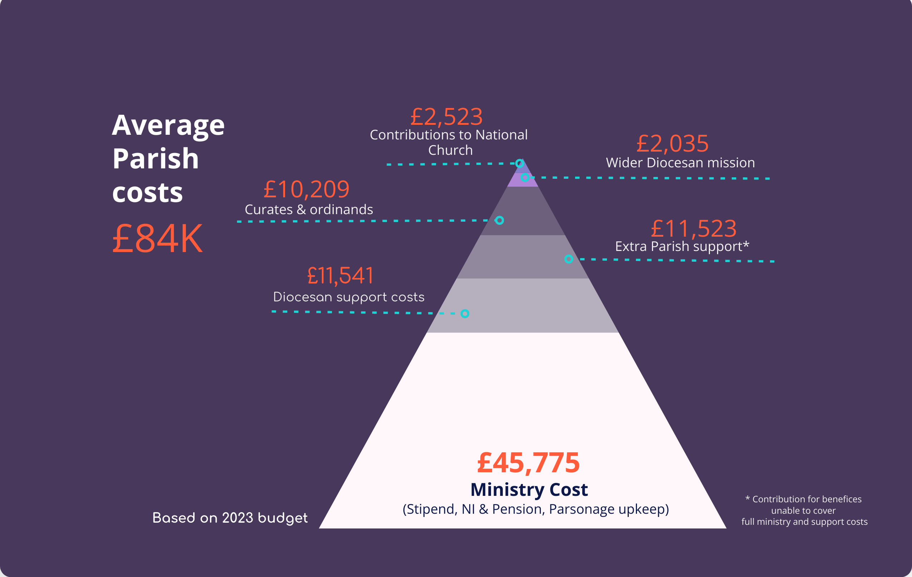
AVERAGE PARISH COSTS 2023
Notes:
These are based on 2023 budgeted figures
On average parishes are asked to contribute £84,000 – some will pay more and some will pay less

Slide 8

MINISTRY COST - 2023
Stipends
28,848
National Insurance
2,725
Pension
8,077
Parsonage upkeep
6,125
£ 45,775
TOTAL
Notes:
The Clergy stipend applies across the board and stands at £28,848 p.a.
The parsonage upkeep covers quinquennial surveys and annual upkeep costs and is an across the board allocation of costs

Slide 9
How does it work?
We use a common formula to calculate a fair and reasonable amount a parish can contribute to the Common Fund.
It’s called an Indicative Offer.

Slide 10
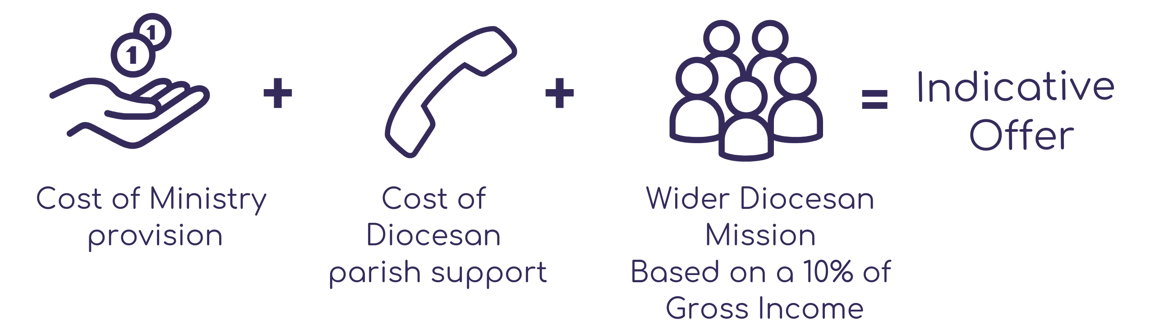
How does it work?
Notes:
This system was reached after a long period of consultation and passed by Synod in July 2019
[If available, include a slide of individual calculation]
For those interested there are guidelines of how this is calculated in the Common Fund leaflet available on the diocesan website: www.rochester.anglican.org/about-us/howwearefunded/

Slide 11
Your generosity enables us to grow
Thank you
Giving in this way it means we:
• have a stable platform from which to grow,
• can support those parishes who are in need, and
• maintain a Christian presence in every community.

Slide 12
“The Church of Jesus Christ does not exist for its own sake, but for the sake of the kingdom of God – that is, for the sake of seeing God’s reign of righteousness and peace prevail in our world.
“This is the Calling of the Church in this Diocese, in all our parishes and communities: to put what we have in the hands of Jesus and to ask him to bless and multiply what we have given, so that the hungry may be fed in both body and soul, and discover more of the love of God for themselves.”
Bishop Jonathan (Taken from his sermon at his Welcome service)

Slide 13
Please pray
Lord,
you have entrusted us with the fullness of all that you have given and empowered us with the presence of your Holy Spirit:
grant to us joy in our stewardship, generosity in our giving, trust in your promises, and confidence in Christ when our deeds are judged; through Jesus Christ, our Lord. Amen.
From ‘Giving in Grace’

