Slide 1
Year 3/4
A learning journey in the Diocesan Syllabus
‘God’ concept using resources from UC & Diocesan ideas.

Slide 2
Long Term Plan for Religious Education for Primary Schools in Chester Diocese
Autumn Term 1b Christian Concept: God Theme: Descriptions of God
Year Group | Enquiry Questions | Essential Knowledge
FS | What do Christians say God is like? | Old Testament David & Goliath: 1 Samuel 16:16-17; God as Shepherd: Psalm 23:1-2 New Testament Jesus’ Teaching: Parables of Lost Sheep and Lost Coin Luke 15:1-7; 8-10
Y1 | Why is the idea of God the creator important to Christians? | Old Testament God the Creator Genesis 1:1- 2:4 Christian Practice Caring and looking after the world Genesis 1:28, 2:18
Y2 | What do some stories in the Bible teach about God? | Old Testament Moses and the burning bush Exodus 3:1-21 New Testament Jesus’ Teaching: Parable of the Good Samaritan (visited in FS ‘God’) Luke 10:25-37 Parable of Two House Builders (visited in Year1 ‘God’) Matthew 7:24-37
Y3 | How do Christians use symbols to explain what God is like? How do Christians use words, prayers, songs or hymns to describe God as ‘three in one’? | God in the Bible Rock: Psalm 18:2; Father: Matthew 6:9; King: Psalm 93; Judge: Psalm 50:6; Matt.25:31-46; Creator: Gen.2:4; Provider: Matt.7:7-11; Perfection: Matt.5:43-48; Shepherd: Ps.23 Christian Practice Trinitarian Prayers & Hymns; The Grace; 2 Celtic prayers Ancient Hymn: St Patrick’s Breastplate ‘I bind unto myself today’
Y4 | What does the story of Daniel teach about God? What did Jesus teach about God? | Old Testament Prayer Daniel 2:19-23; 6:10-11 Faith Daniel 3:16-18; 6:17-21 New Testament Jesus’ Teaching: Parable of the Lost Son Luke 15:11-32 Parable of Ten Girls Matthew 25:1-13; Lord’s Prayer: Matthew 6:9-15; Luke 11:1-4 Two Greatest Commandments: Matthew 22:37-39; Luke 10:27-28
Y5 | How do Christians believe God speaks to people through the Bible? Why is it important for Christians to describe God as ‘three in one’? | Old Testament Moses and the plagues: Exodus Chapters 7-12 New Testament Jesus’ Birth: Emmanuel, ‘God with us’: Matt 1:23 (see Isaiah 7:14) Christian Belief Trinity: Jesus’ Baptism: Matthew 3:1-17; Luke 3:1-23; Apostles’ Creed
Y6 | How do different Christians describe God? | Christian Belief God as: Omniscient; Omnipotent; Omnipresent

Slide 3
KEY QUESTIONS | Learning Objectives | Learning Outcomes
How do Christians use symbols to explain what God is like? YEAR 3 Chester Diocese learning intentions & outcomes (School’s cycle A) How do Christians use words, prayers, songs or hymns to describe God as ‘three in one’? | The children will learn: Christians believe God can be described in many different ways: creator, sustainer, almighty, father, and judge. Christians believe there is one God in three persons. (Trinity). How Christians identify the three parts of the Trinity. To talk about God using Christian symbolism. To talk about their own ideas about God. | By the end of this unit: Emerging (Some children) I can use some religious words to say how Christians describe God. I can talk about some people’s beliefs about God. I can say what I think about my own ideas about God. Expected (All children) I can describe what some Christians believe about God. I can make a link between my own ideas about God and those of others. I can suggest some meanings in Christian symbols about God I can use a metaphor to describe God. Exceeding (Few children) I can describe the impact of believing in God on some Christian people. I can show I understand different opinions about God I can compare some Christian ideas to my own ideas about God.

Slide 4
Questions to consider
What does each piece of work tell you? Can I identify the context for each piece of learning? Eg activity, resources used and why set?
For each activity can I track the learning process?
Can I identify teacher interaction and subsequent pupil response?
How is learning moved on? Eg marking. What should come next?
How are assessment end of unit tasks set?
Does the learning journey meet expected outcomes? Higher? Lower?
How could we deepen the children's learning? Take it even further?

Slide 5
Pupils Asking questions about God
Step 1
Recapping on previous learning about God using class mind maps & additional questions from last year.
Do you have parents?
Do you live somewhere in particular or in heaven?
Do you have another name?
God is an amazing mystery?
How did you make people?
Why did you choose earth? What about Jupiter and Mars?
How do you live so long?
Are you married or how could you have a child or did you just create him?

Slide 6
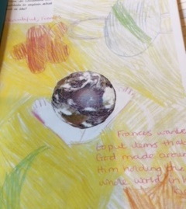
How do Christians use symbols to explain what God is like? What do you think God is like?
Teacher comment
‘Beautiful Pupil A.
She wanted to put items that God made around the whole world in his hands.’
Step 2
The class were introduced to the Key unit question and asked to make initial responses.
Teacher’s Question: Where would you begin this unit of work?

Slide 7
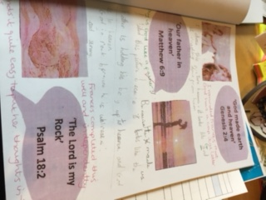
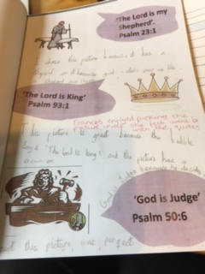
Step 3 Using a Diocesan PowerPoint Yr.3 God
Teacher Comment ‘Pupil A enjoyed picking the picture she felt went with the quotes’. ‘She completed this well and independently. She finds it quite easy to put her thoughts into words’.
‘I chose this picture because it has a shepherd on it ,god watches over is like a shepherd and sheep.
‘I chose this picture because its like God reaching from heaven’.
‘I like this picture because he made us and it looks like the father is holding his boy to heaven and God is in heaven.’.
‘This picture is great because the bubble says, The Lord is king’ and the picture has a crown’.
‘God is rock because he is real and strong.’.
‘This picture is perfect because God is judge because he decides what's fair’.

Slide 8
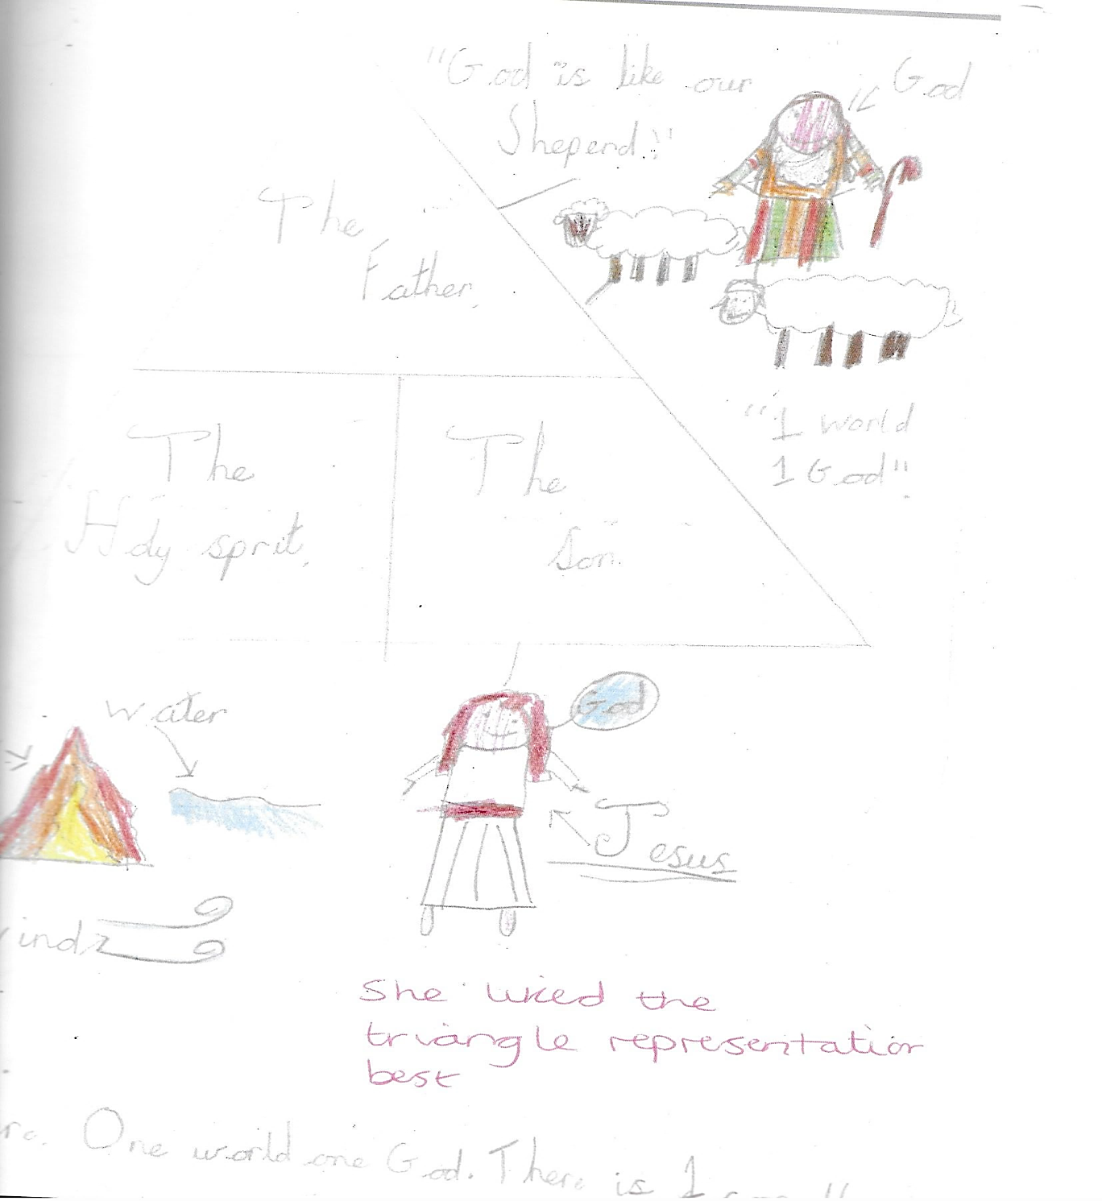
Pupils are asked to select images to show the 3 in 1 aspects of the Trinity
Pupil Comment
‘God is like our shepherd. 1 world 1God’
‘There is one for all’
Step 4
Extending the idea of God &
introducing the Trinity
Father
The Holy Spirit
The Son
Pupil A used :
A triangle: Water, ice, steam
Teachers Question: How would you introduce the idea of the Trinity to your class? What process of learning would you use? Would this be your next step?

Slide 9
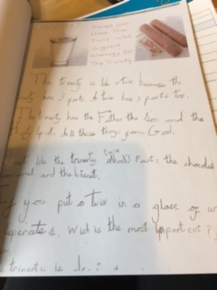
Pupil A felt the Twix was a good analogy for the Trinity. UC Resource Idea
‘The Trinity is like a Twix because the Trinity has 3 parts and the Twix has 3 parts.
The Trinity has the Father, Son and the Holy Spirit. All these things form God.
Just like the Trinity a Twix has 3 parts, the chocolate, caramel and biscuit.
If you put a Twix into a glass of water to separate which bit is the most important?’
If you took the Holy Spirit from the Trinity it wouldn’t be the Trinity.’ (U
Teacher’s Question: Is this a good image for the Trinity? What other images could be used to explain the Trinity?

Slide 10
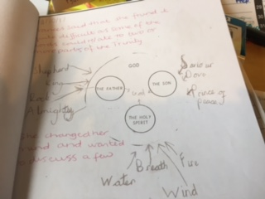
Step 5 Extending the idea of God & considering the different roles of the Trinity
Matching different symbols to various parts of the Trinity. UC Resource Idea
Teacher Comment in red ink on pupil's work below
‘Pupil A said she found it difficult as some of the words could relate to 2 or more parts of the Trinity.
She changed her mind and wanted to discuss a few.’

Slide 11
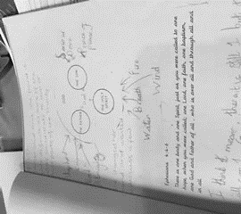
Step 6
Looking & linking ideas
Ephesians 4:4-6 There is one body & one spirit, just as you were called to one hope; one Lord, one faith, one baptism, one God & father of all who is over all through all & in all.
Pupil Response
‘I think it means there is still 1 but its all for 1. God is everything and everywhere’.
Teacher’s Question: What next step would you use? Would you use the same or different Bible verses here?

Slide 12
Step 7 Examining prayer for understanding God & Trinity
St Patrick's breastplate is important because…….
‘It tells us about the Trinity. It tells us about God. Bind and Trinity are possibly the most important words. Bind because it means keep something in your heart. Trinity because it is God the Father, God the Son and Holy Spirit’. Frances
Teacher Comment
‘Good verbal discussion with Pupil A about what the word ‘bind’ meant.’
Teacher’s Question: How would you move the learning on? How would you ensure greater depth of learning? What process of learning do you use?
How do you know when it works?

Slide 13
Step 8 RE Assessment Task Year 3
How do Christian people view God? How does all our research show where they get their ideas from? Can you create an abstract design or symbol that shows how Christians view God?
Pupil written response
God is….
‘The best way to learn about God is in the bible. There is an old and new testament. God isn’t a human he lives in heaven (a place in the sky). Christians believe God will forgive you if you are truly sorry. God is actually 3 things, the Father, the Son and the Holy Spirit. This forms the Trinity. Let me show you before I do. I will talk some more about God. God sent down his only son Jesus. God was at the beginning of the world, this is the beginning of the Old Testament. Jesus had his disciples, I wont tell you about them because we are talking about God.’
Teacher’s Question: How would you assess the pupil’s understanding of God according to the Diocesan end of unit outcomes? What process of learning did you use?

Slide 14
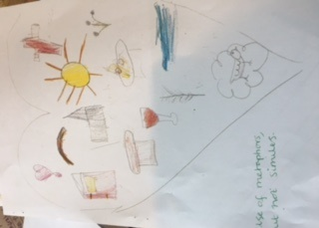
Pupil A’s abstract design for how Christians view God
Teacher Comment ‘Use of metaphors not similes’.
Pupil Comments
‘I chose the Bible because there is where we read about God. Bread and wine it was eaten at the last supper. White feathers because it means someone in heaven is thinking about you. To me God is a shepherd because he watches over us all the time. God is always with us.’
Teacher’s Question: What would you say are the next steps for learning?

Slide 15
Teacher Assessment: This work showed evidence for the expected level & some elements for exceeding level
Expected (All children)
I can describe what some Christians believe about God.
I can make a link between my own ideas about God and those of others.
I can suggest some meanings in Christian symbols about God
I can use a metaphor to describe God.
Exceeding (Few children)
I can describe the impact of believing in God on some Christian people.
I can show I understand different opinions about God
I can compare some Christian ideas to my own ideas about God.

