Slide 1









FAMILY MOVIE AFTERNOON
Bring your loved ones together for a afternoon of laughter, adventure, and heartwarming moments.
SUNDAY, 23 FEB, 2025
START AT 2:30PM
WHITTLESEY QUEEN ST CHURCH
PRESENTS
FREE ENTRY DONATION WELCOME
timwongwhittlesey@gmail.com
https://www.whittleseyqueenstreetchurch.org/
24 Queen St, Whittlesey, Peterborough PE7 1AY

Slide 2

What have you learnt from the characters?
Talk to the one sit next to you

Slide 3
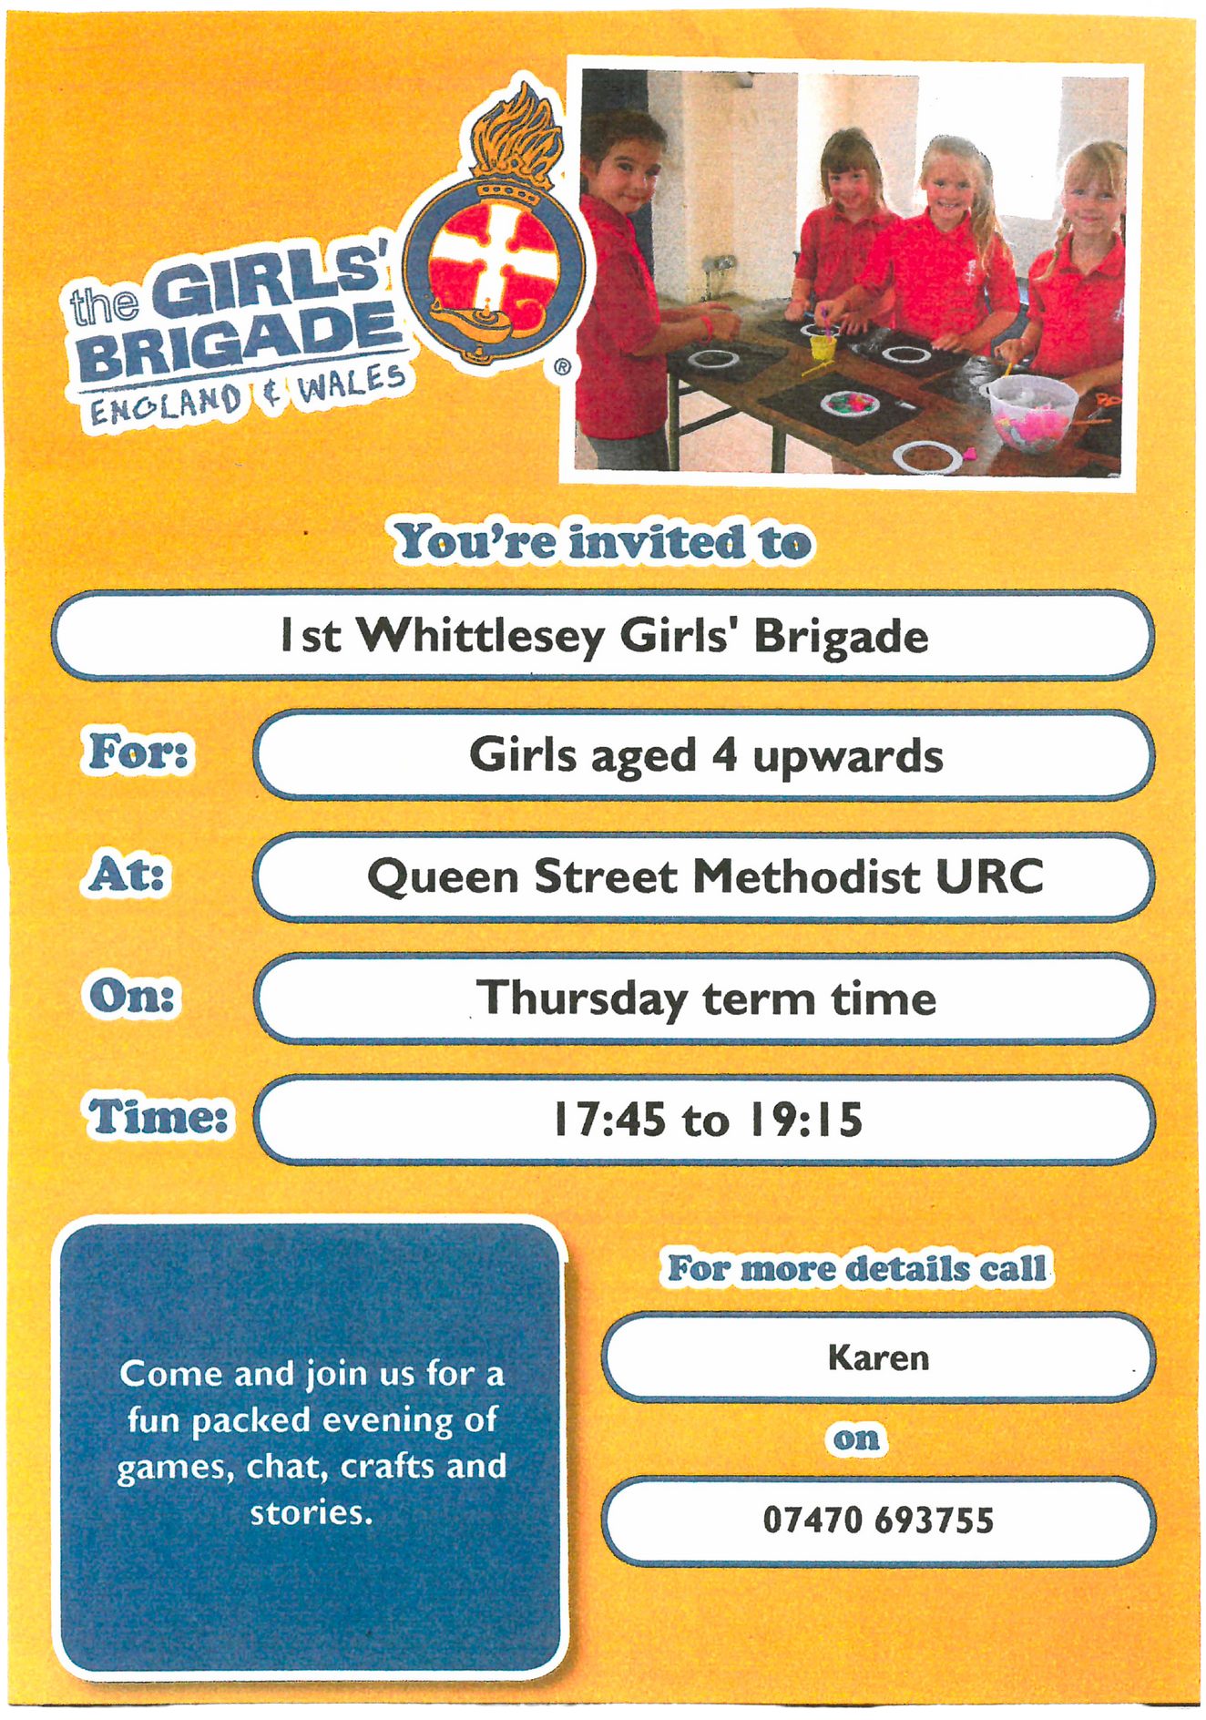
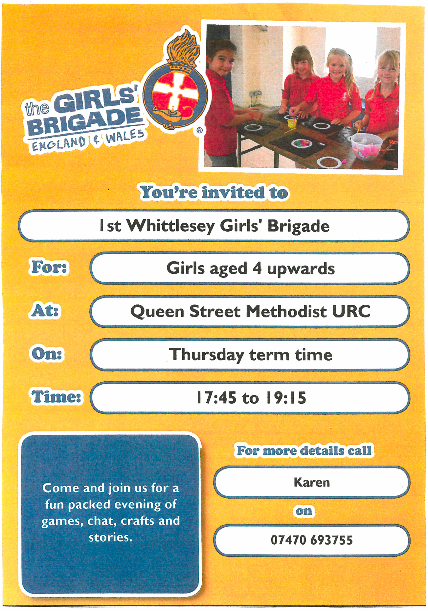

Slide 4


Slide 5



Messy Church
2025
Easter Sunday, 6th April
Summer Sunday, 22nd June
Harvest Sunday, 6th October
Christmas Sunday, 7th December

Slide 6



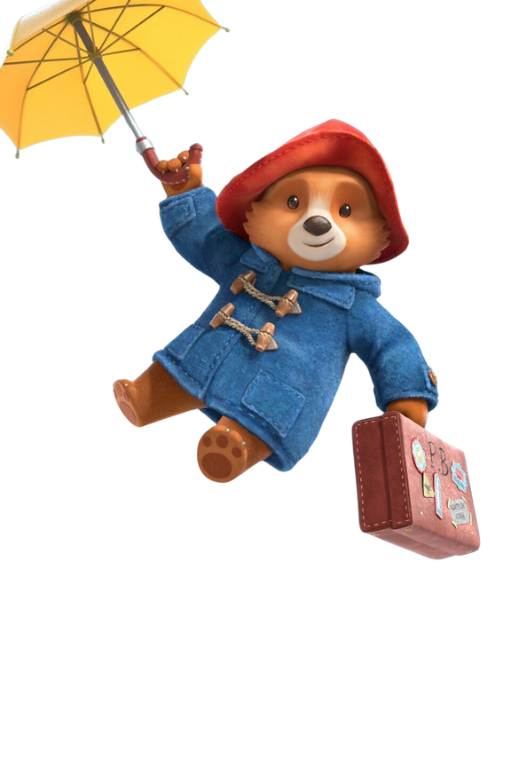
Next Film on 16th Mar Sun
Paddington
Narnia

